Slide 1
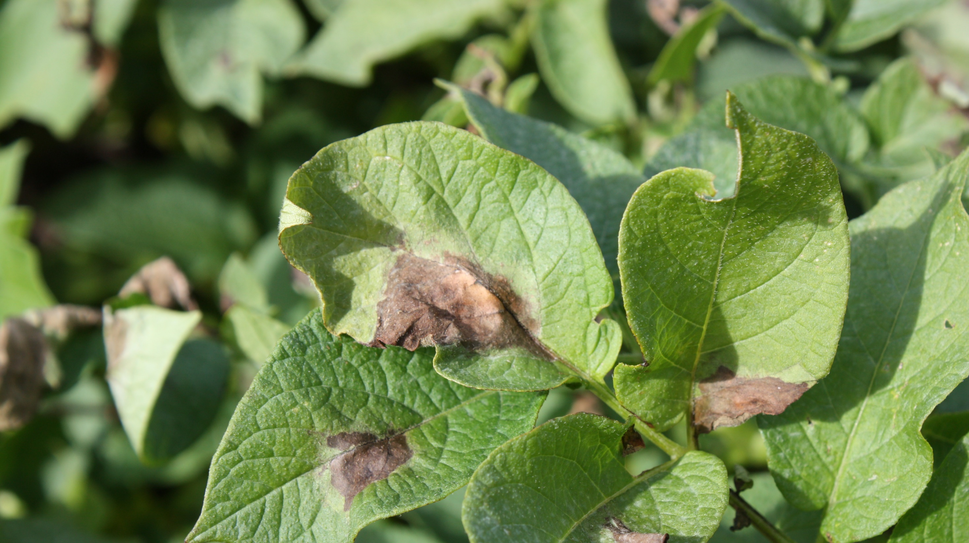

Beyond TFA-pesticides
Denmark’s path to a future potato production.
Lars Bødker
PAGER 16. – 18. March 2026

Slide 2
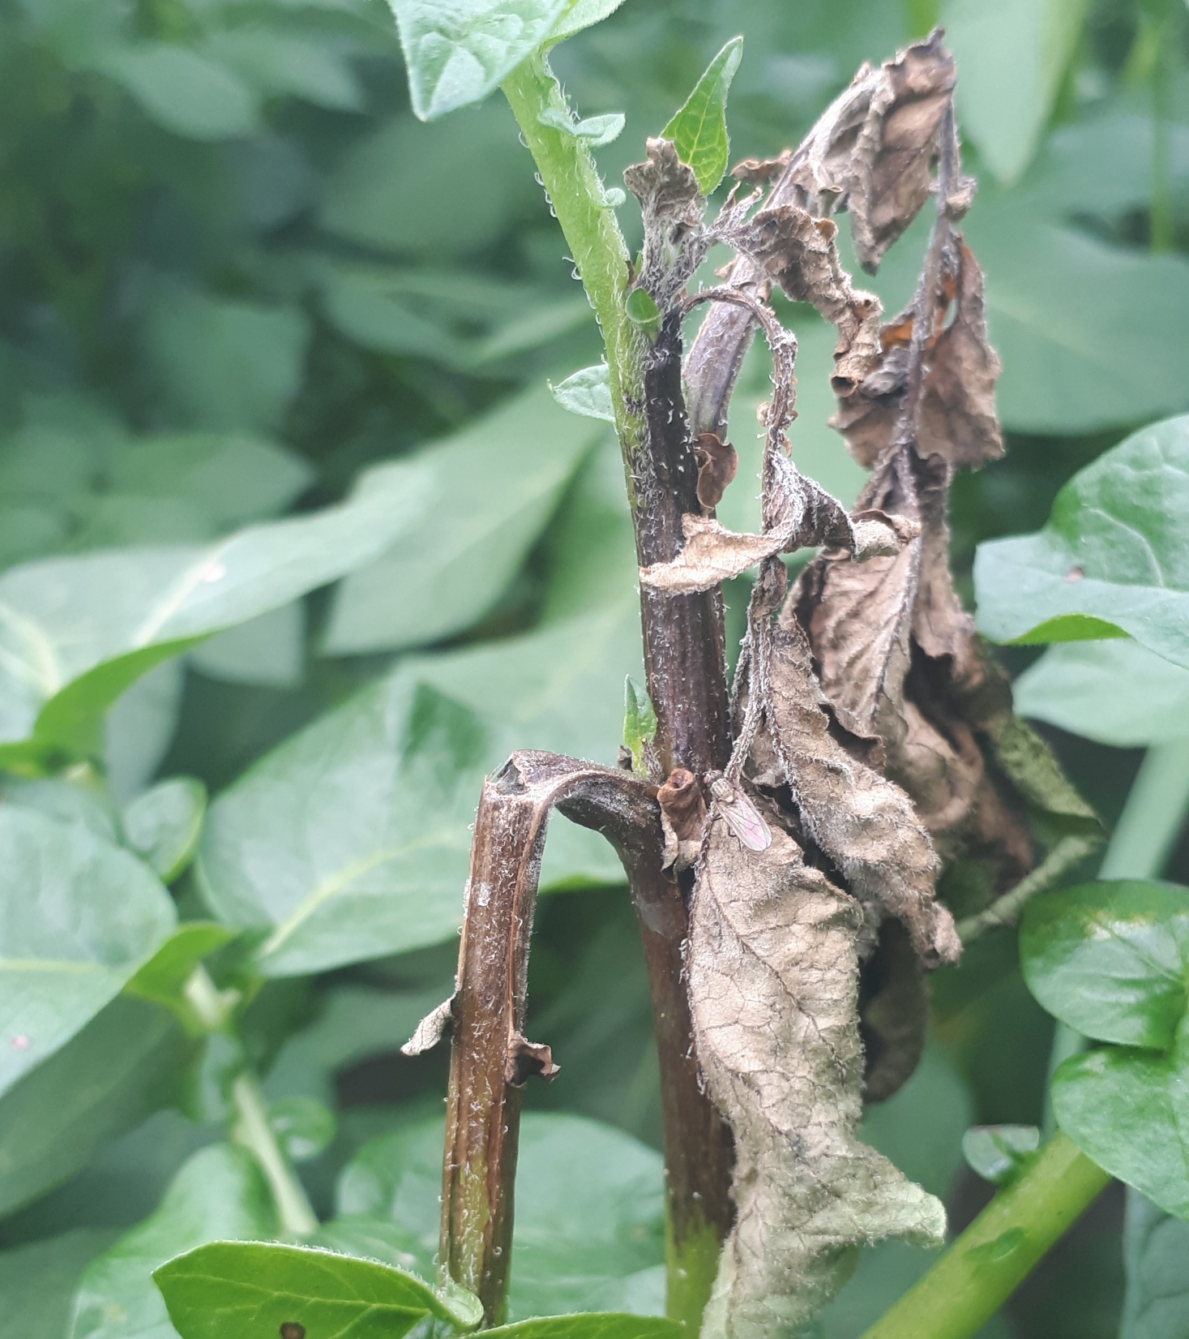
Agenda
Potato late blight has never been a problem!
Availabel fungicide – 2026
IPM/ICM
Effect of crop rotation?
Synergism between MoA and Rpi-genes
Deployment and landscaping of Rpi-genes
DDS – early warning – camera technology
Other technologies

Slide 3
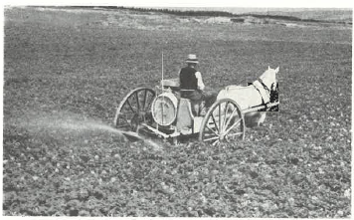
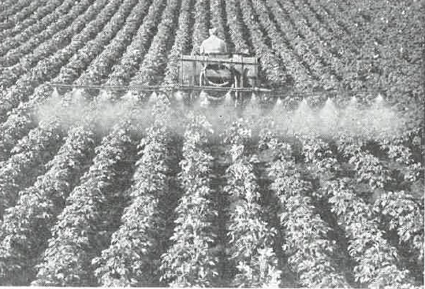
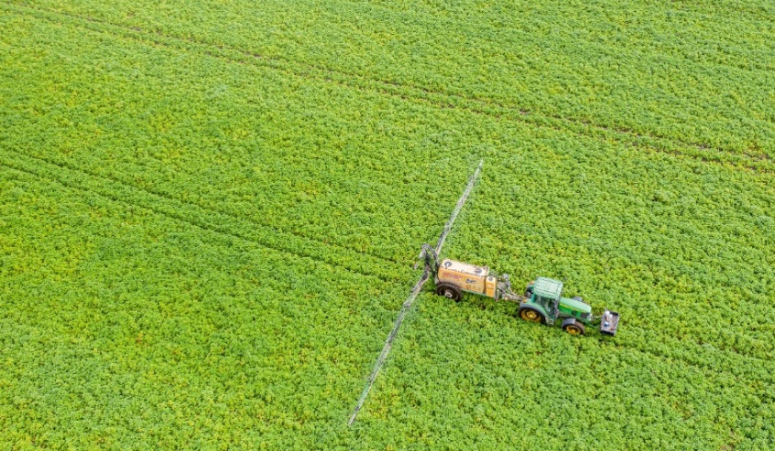
Late blight has never been a problem – before now!
skksk
1880 -1944
1-2 treatments
1962
2 treatments
2023-2026
10-14 treatments
Frederiksen, T
Møller Eriksen, N
Klemmensen, P
Bordeaux mixture
Mancozeb
  Fluazinam, Oxathiapiprolin, Mandipropamid , Cymoxanil, Propamocarb, Fluopicolide, Cyazofamid, Amisulbrom, Ametoctradin, Kobberhydroxide, Phosphonates, Metalaxyl-M

Slide 4
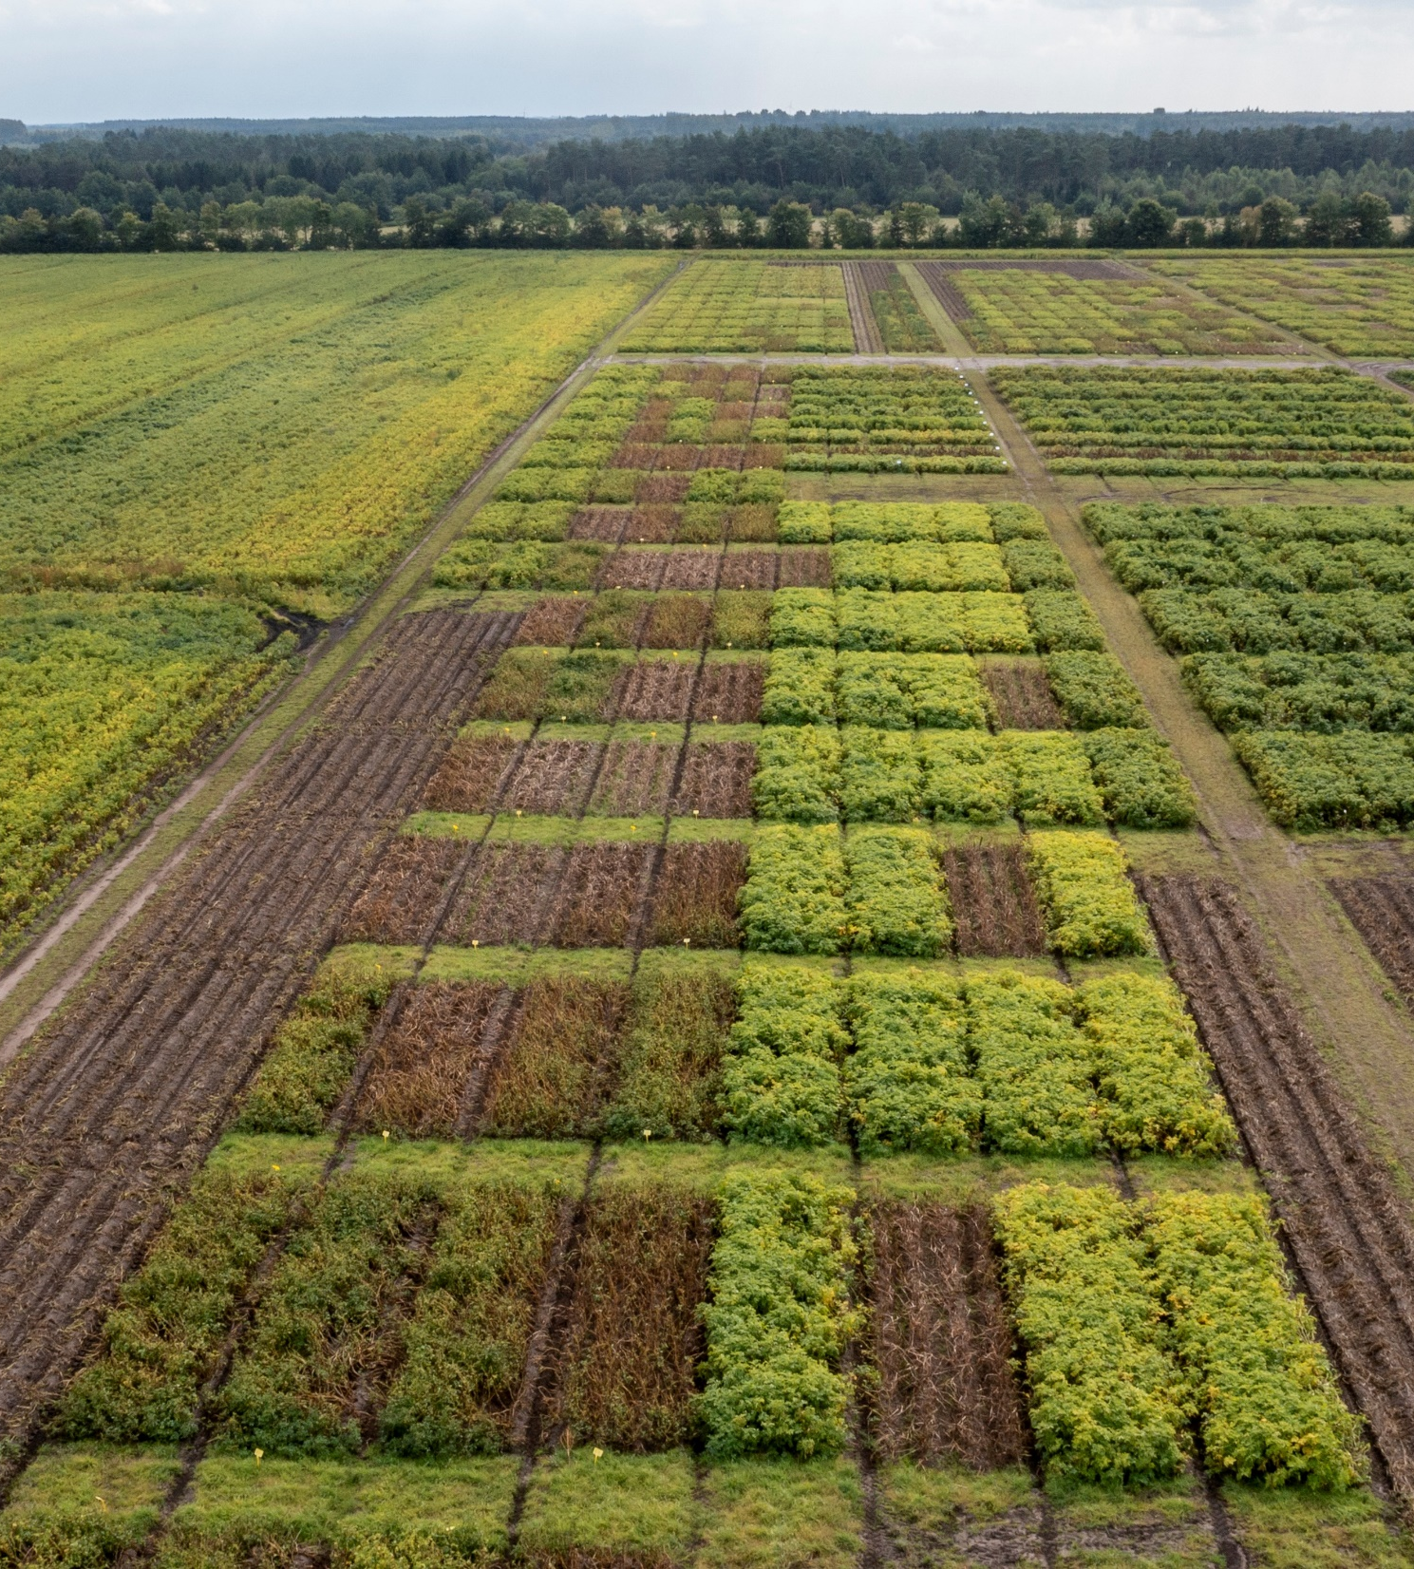
Importance for yield
21 trials (2012 til 2017)
Starch yield, hkg
47 percent loss
Late blight (17.-26. aug.), percent
(Source: AU - Bent J. Nielsen & Niels Holst 2017)
Foto: Nordisk Alkali

Slide 5

Prevention of Corona
Reduce infection pressure – it’s all about statistic
💉Vaccination
🧼 Good hygiene
🌬️ Ventilation
🤒 Stay at home
😷 Use mask
👥 Keep distance
🧪 Test when symptoms or after exposure
📊 Follow infection rates
Foto: AI generated

Slide 6
Availabel fungicide - 2026
Denmark
  Fluazinam (ban from 2027)
  Oxathiapiprolin
  Mandipropamid
  Cymoxanil
  Propamocarb
EU
  Fluazinam
  Oxathiapiprolin
  Mandipropamid
  Cymoxanil
  Propamocarb
  Fluopicolide
  Cyazofamid
  Amisulbrom
  Ametoctradin
  Kobberhydroxide
  Potassium phosphonate
  Metalaxyl-M

Slide 7
Availabel fungicide - 2027
Denmark
  Fluazinam (ban from 2027)
  Oxathiapiprolin
  Mandipropamid
  Cymoxanil
  Propamocarb
  Ametoctradin
  Phosphonates
  Fosetyl – Al
  Cyazofamid?
EU
  Fluazinam
  Oxathiapiprolin
  Mandipropamid
  Cymoxanil
  Propamocarb
  Fluopicolide
  Cyazofamid
  Amisulbrom
  Ametoctradin
  Kobberhydroxide
  Potassium phosphonate
  Metalaxyl-M

Slide 8
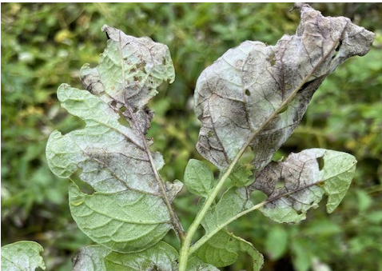
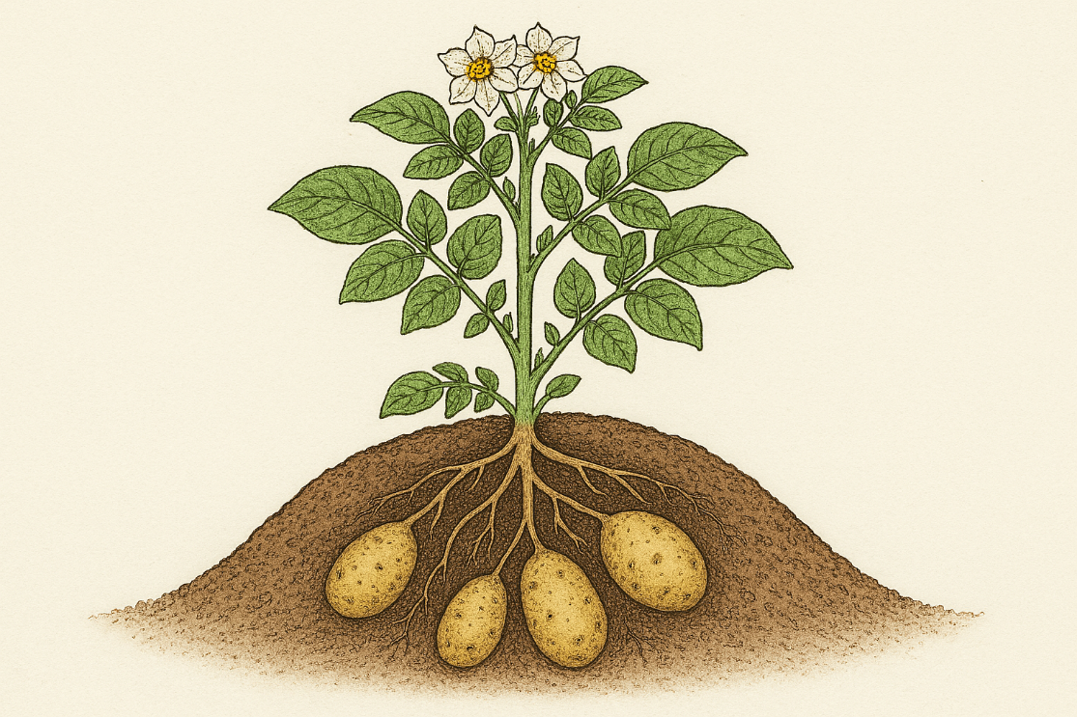
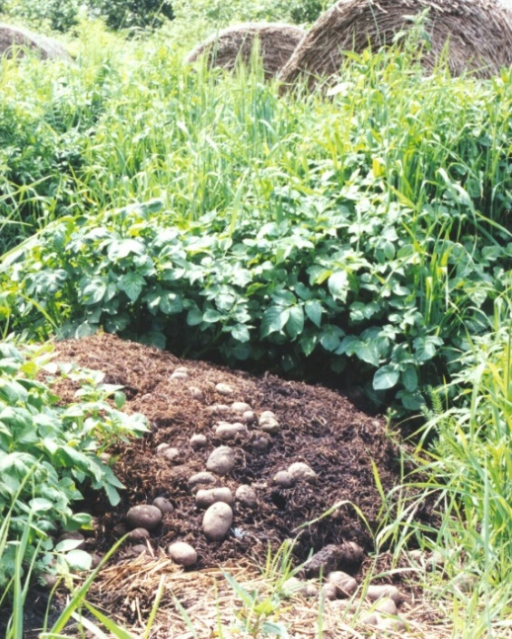
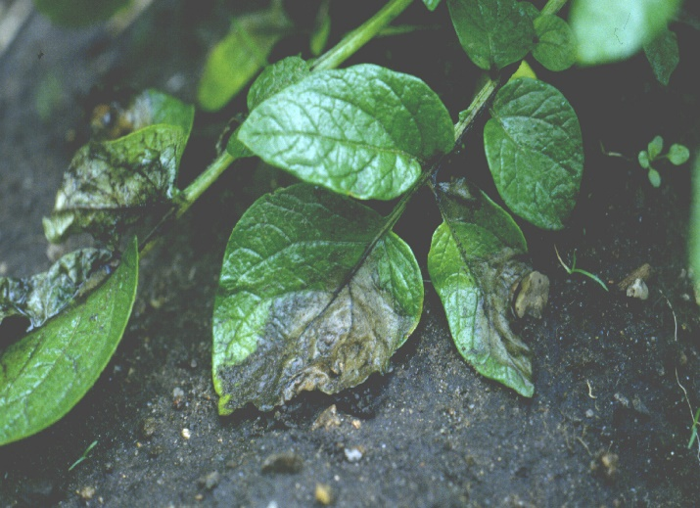
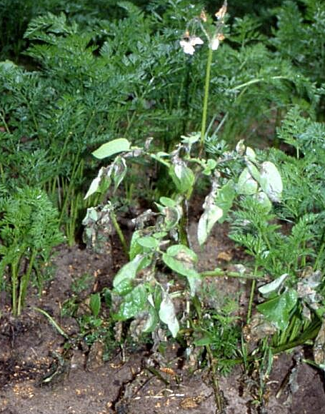
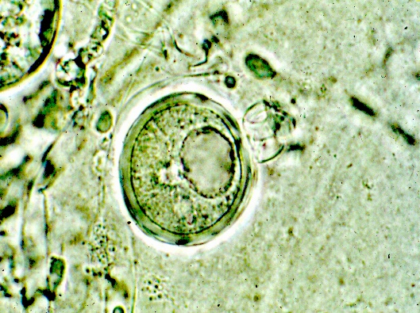
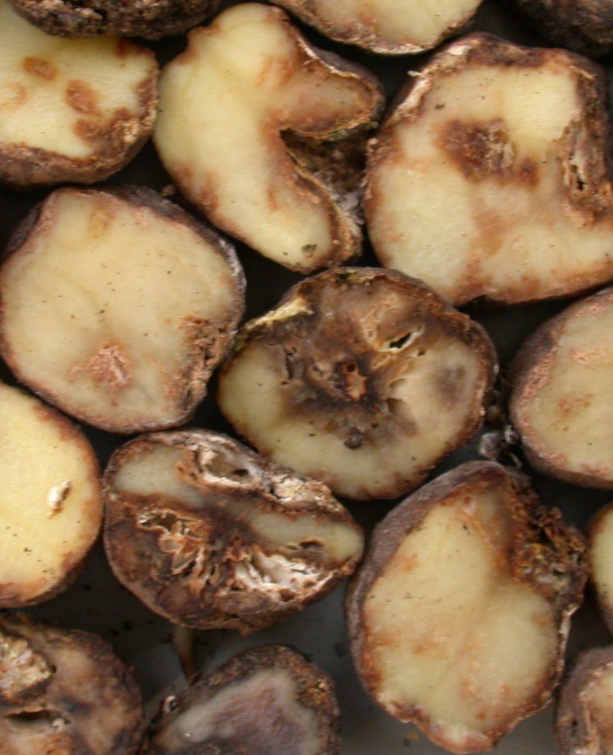
IPM/ICM
Prevention of infection and disease development (virulence – fungicide resistance)

Slide 9
IPM/ICM
Prevention of infection and disease development (virulence – fungicide resistance)

Slide 10
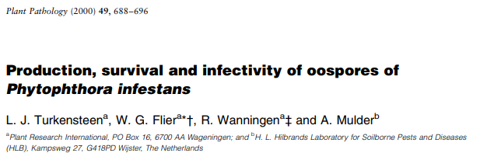
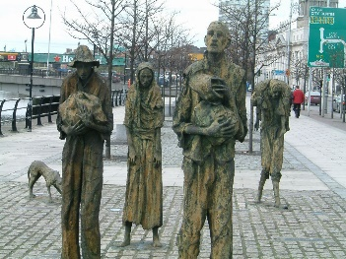

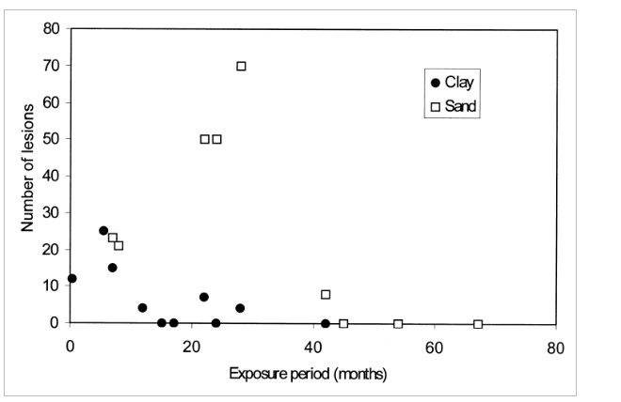
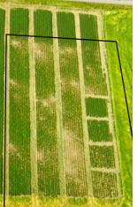

History of oospore – renewal of focus!
Single R-genes breakdown
Single site MoA breaks down
Virulence and fungicide resistance is linked to region
Biggest genetic diversity in genotypes in Europe
EU41, EU43, breakdown Rpi-vnt1.1, ……
A1
A2
A2
Hohl &Iselin 1984
Andersson et al. 1998
1845-1852
1976
1984
1992 - 2001
2026
Aprox. 25 yr
Aprox. 25 yr

Slide 11


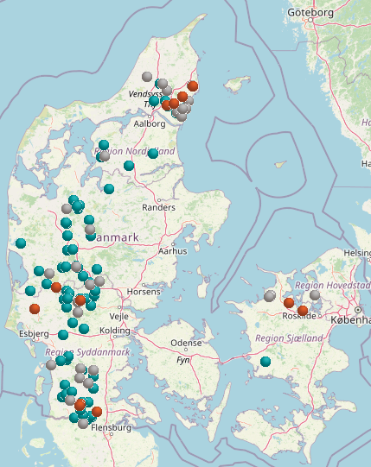
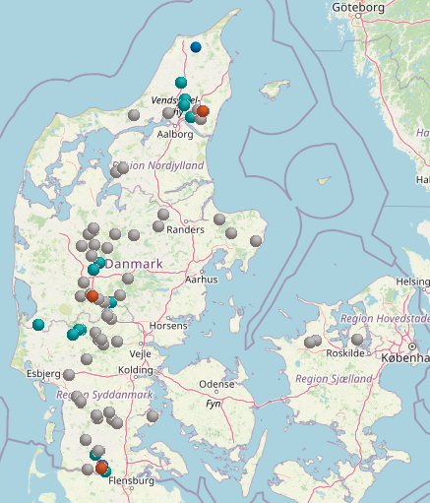
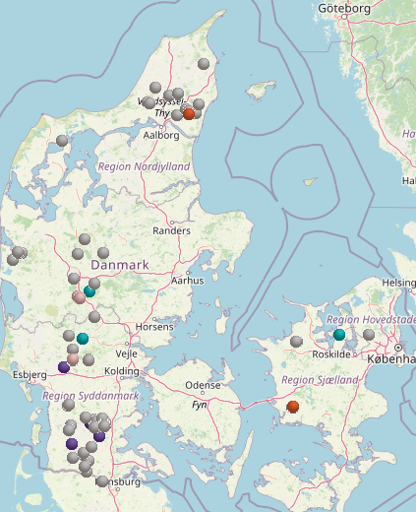
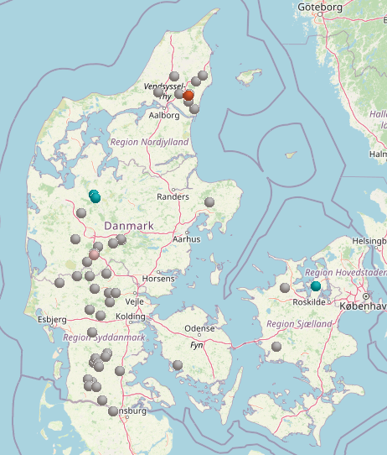



Effect of mix- and alternation strategy
2022 (64 pct.)
2023 (20 pct.)
2024 (5 pct.)
2025 (4 pct.)

Slide 12
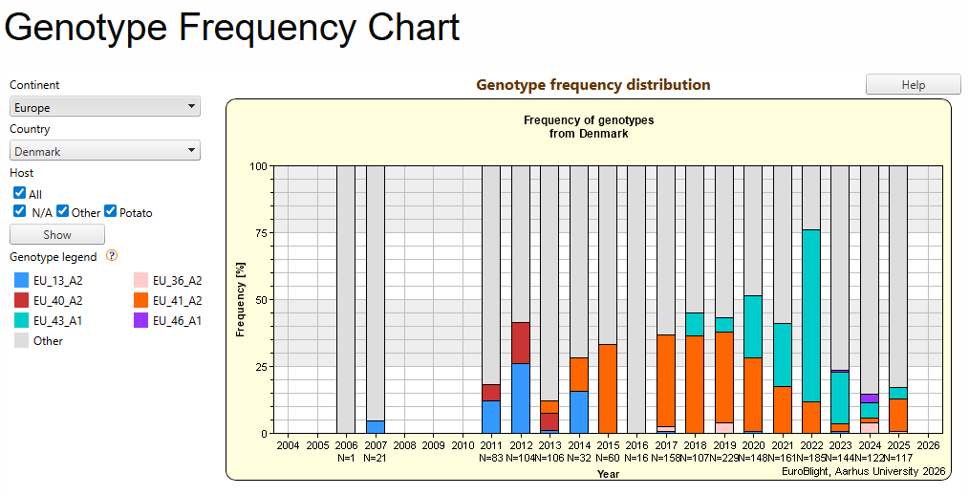
Frequency/presence of ”others” increasing?

Slide 13
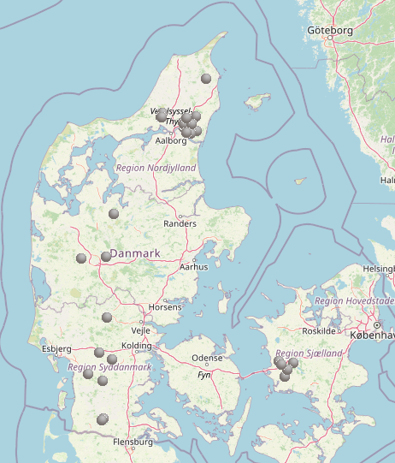
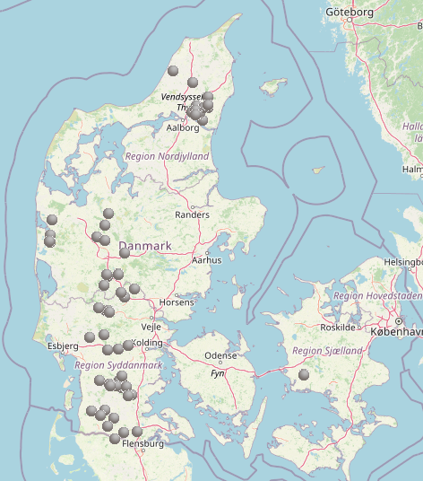
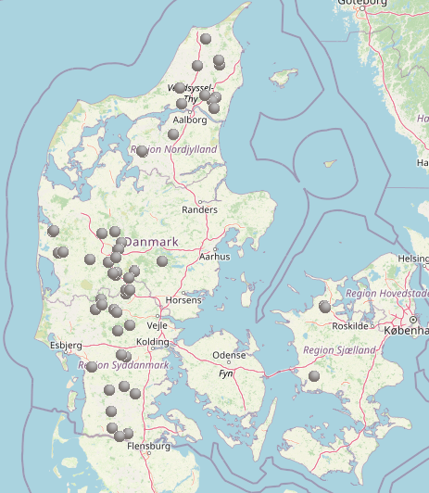
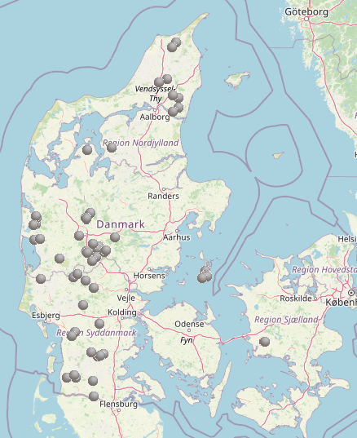
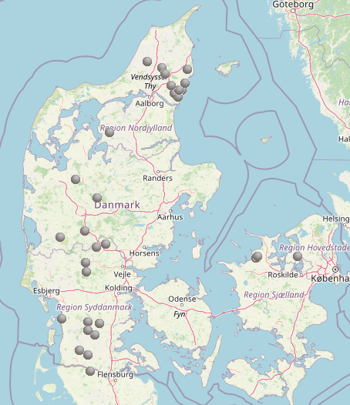
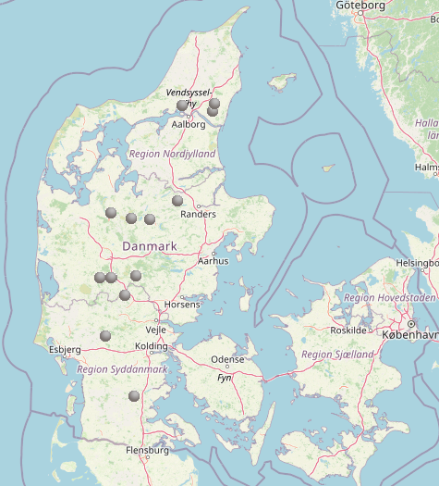
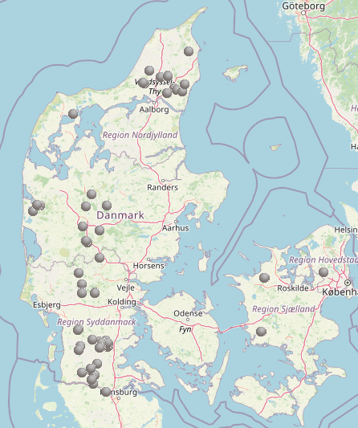
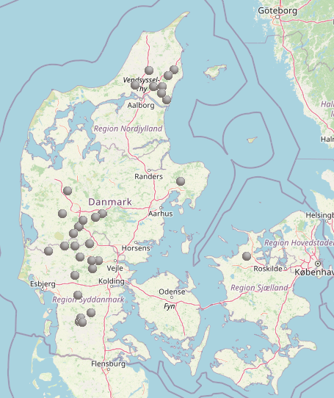
Sexual recombiantion – every year!
2018
2019
2020
2021
2022
2023
2024
(2025*)

Slide 14
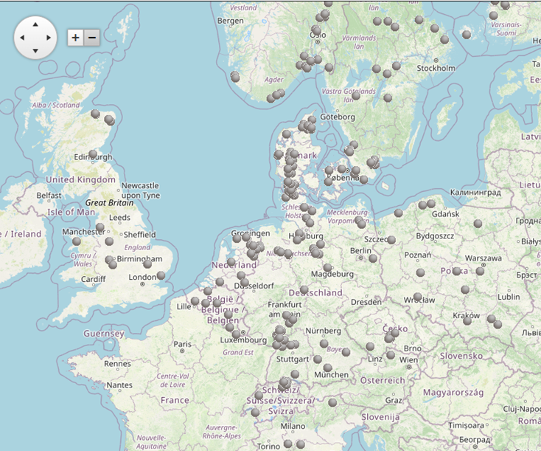
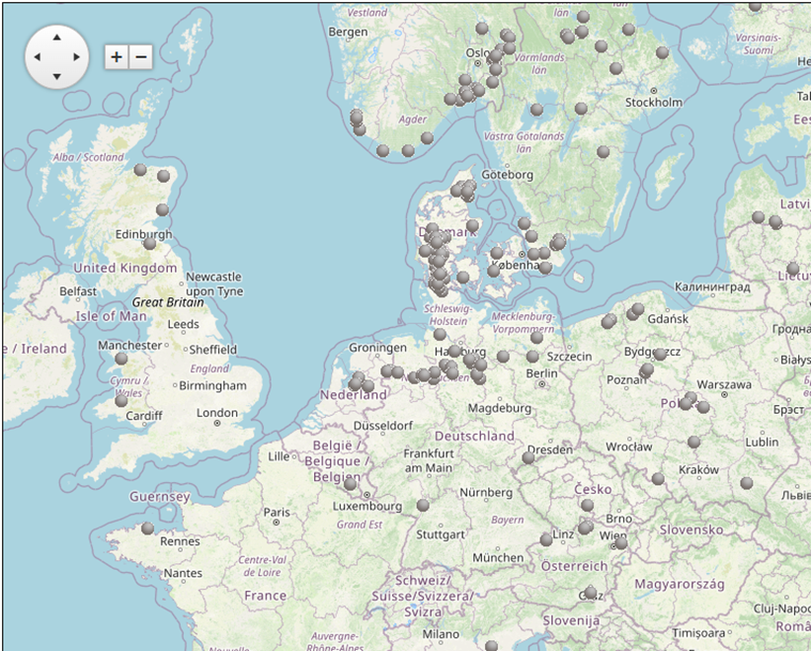
Sexual recombination in Europe
2024
2025

Slide 15
Survival of oospores (”short” term survival structure?)
At least 2 years in Sweden (Andersson et al., 1998)
At least 4 winter in Scandinavia (Nordskog et al., unpublished data)
At least to the next growing season in Finland(Lehtinen and Hannukkala 2004)
Up to 4 years in Holland (Turkensteen et al., 2000)
Survival of two years in Mexico (Fernandez-Pavia et al. 2004)

Slide 16
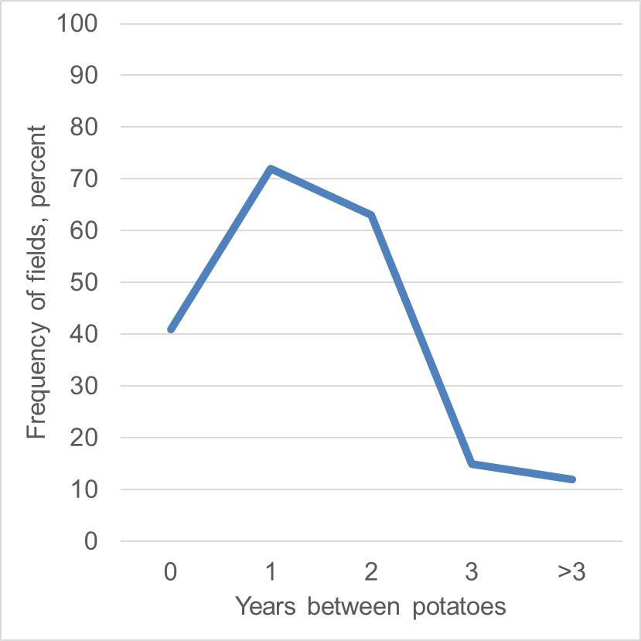
Crop rotation and late blight?
Frequency of fields with blight
(Source: Bødker, L., Pedersen, H., Kristensen, K., Møller, L., Lehtinen, A. & A. Hannukkala 2006.)

Slide 17
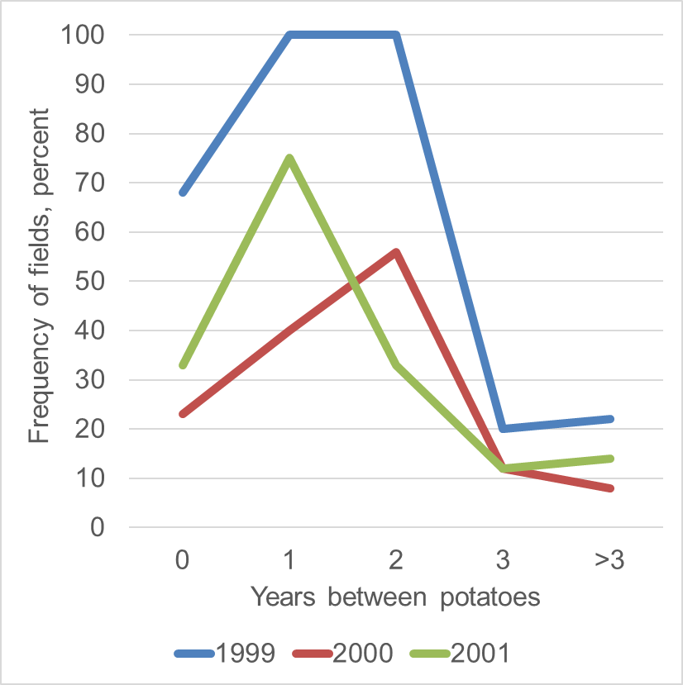
Crop rotation and late blight?
Frequency of fields with blight
(Source: Bødker, L., Pedersen, H., Kristensen, K., Møller, L., Lehtinen, A. & A. Hannukkala 2006.)

Slide 18
Crop rotation and late blight?
Frequency of fields with blight
1
2
5
6
21
4
13
18
6
35
18
17
17
16
7
(Source: Bødker, L., Pedersen, H., Kristensen, K., Møller, L., Lehtinen, A. & A. Hannukkala 2006.)

Slide 19
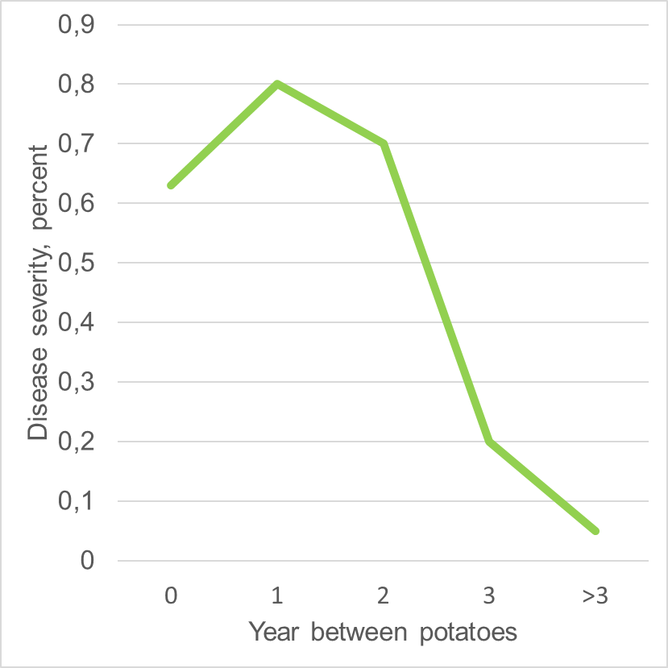
Crop rotation and late blight?
Disease severity
(Source: Bødker, L., Pedersen, H., Kristensen, K., Møller, L., Lehtinen, A. & A. Hannukkala 2006.)

Slide 20
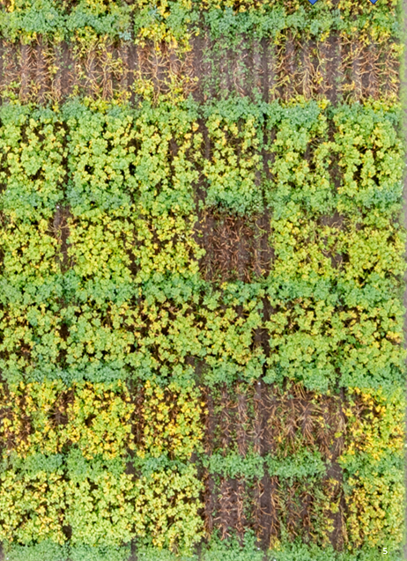

Synergism between MoA and R-genes
Non-treated
Mandipropamid
Fluazinam
AKV 706 – Rpi X
Janick – Rpi Y
Fyone – Rpi Z
Ydun
Kuras – R2

Slide 21
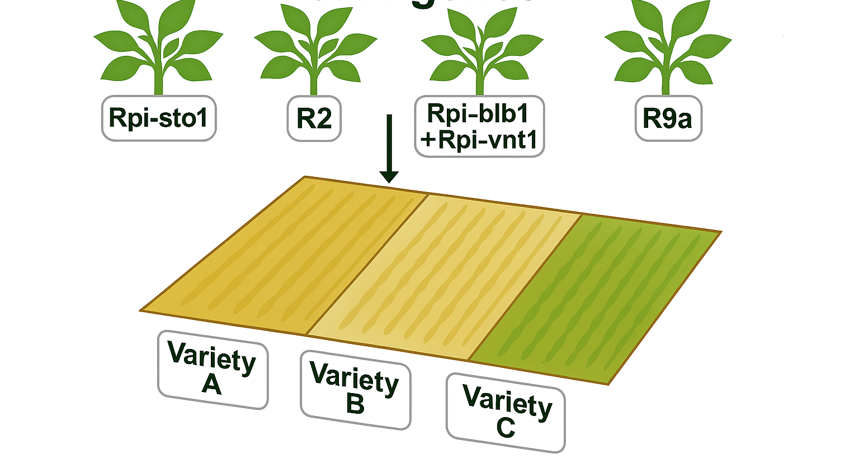
Deployment and landscaping of R-genes

Slide 22
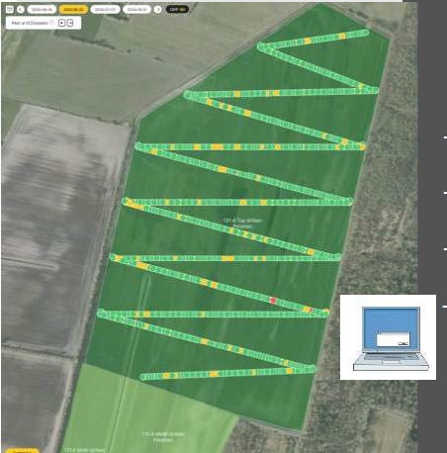
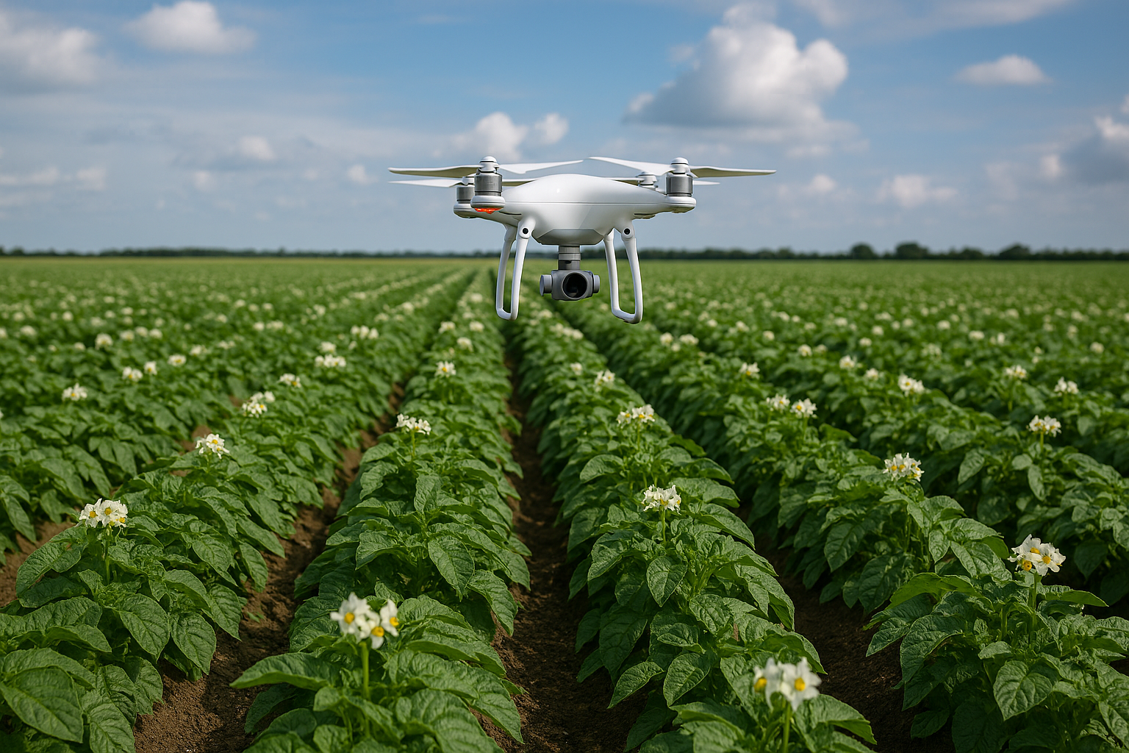
Scounting - camera on drones and tractor
System: Agroscout

Slide 23
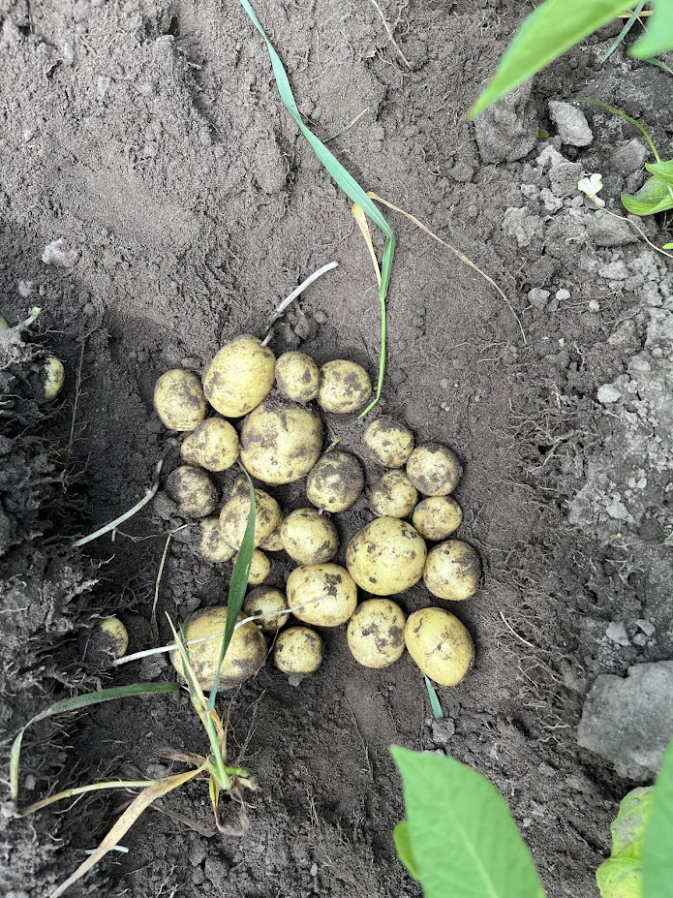
Other technologies
IPM/ICM
New varieties (4-5 Rpi-genes in combination with minor genes)
New varieties with a shorter growing season
New chemical and biological control agents?
Mix and alternation strategies
Synergism between Rpi-genes and MoA’s
Improvements of DSS
Prevention of inoculum sources
Longer rotations (need to be validated)

Slide 24
