Slide 1
Salmonella Dublin
DISARM - crossvisit
15-03-2022

Slide 2
Eradications of infectious diseases in cattle in Denmark
1
Screening
2
Surveillance
Mandatory actions
3
Surveillance/eradication
Governmental restrictions in positive herds
Voluntary actions
Notes:
Tubrculose 1959
Brucellose 1962
IBR 1991
Bvd

Slide 3
Surveillance programs in Danish cattle herds
SEGES
Infectious Bovine Rhinotracheitis (IBR)
Bovine Virus Diarrea (BVD)
Enzootic Bovine Leucosis (EBL)
Salmonella Dublin
Streptococcus agalactia
Danish Veterinary and Food Administration
Bluetongue
BSE
Bovine Tuberculosis
Bovine Brucellosis

Slide 4

Salmonella eradication– why?
More disease in infected herds.
Less production in infected herds.
Risk of salmonella contamination to personnel in infected herds.
Risk of transmission of salmonella bacteria to beef-food safety.
Risk of infection to other herds in the immediate vicinity

Slide 5

Salmonella Dublin Facts
Salmonella Dublin is a bacteria that primarily infects cattle
The bacteria spreads primarily with faeces
Small doses of the bacteria leads to an increase in the antibody level in the animal
Calves under 6 months are most susceptible, but animals of all ages can be infected
Salmonellosis is difficult to treat with antibiotics
Salmonella can survive for months or years in the environment
Notes:
12-24 hours efter uptake in can be shed in faeces

Slide 6
Surveillance - salmonella
Surveillance
Bulk tankmilk
Herd
Blood or milk sample, heifer rearing
Individual Animal
Blood from slaughter
Herd
Salmonella 4/yearly,
Salmonella 1 – 2/yearly
Salmonella 4/yearly,

Slide 7
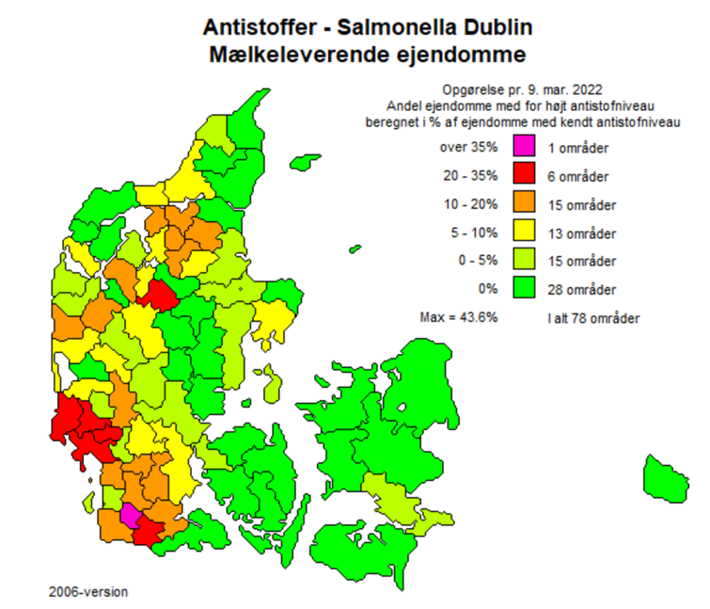
Salmonella Dublin
10,9 % of dairy herds is positive
The goal is eradication

Slide 8

Legislation
Limited sale of live animals in Denmark
Mandatory blood test of calves/heifers
Visitors (vets, hoof trimmers etc.) has to visit negative herds first
Mandatory action plans
Visits 2x year from inspectors from Danish Veterinary and Food Administration

Slide 9
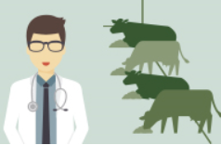
Project - helping farmers with salmonella
Farm visits
  Focus on hygiejne
  Farmer knowledge
  Motivation
  Action-plan
Follow-up
Cooperation with herd-vet

Slide 10
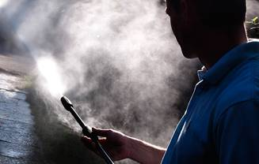
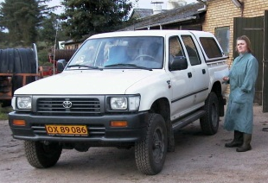
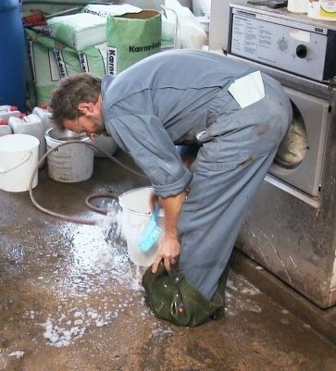
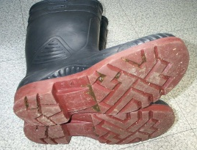
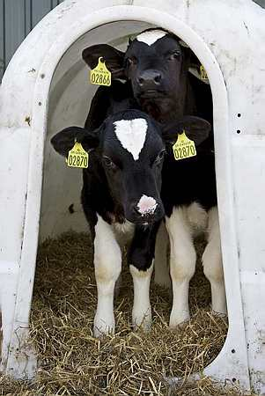
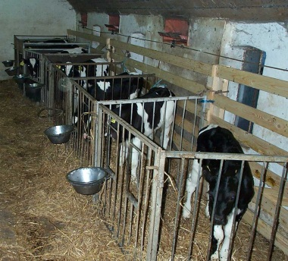
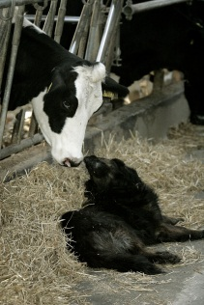
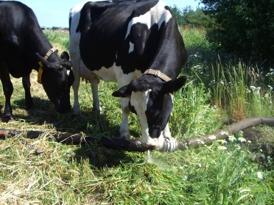
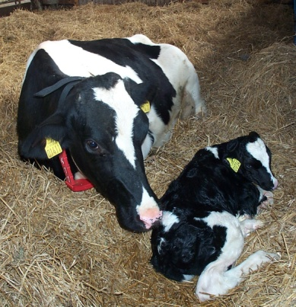
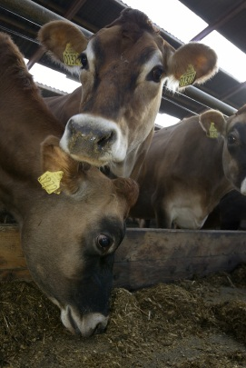
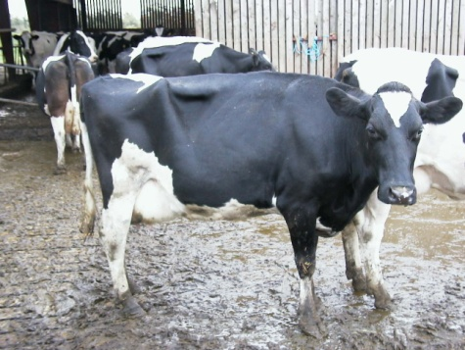
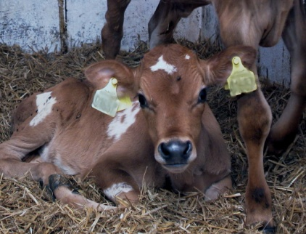
Transmission rutes
We only need a few grams of faeces with salmonella from another calf or cow to be infected with
Salmonella Dublin!
Aerosoler
People
Calf housing
Calving pen
Carriers
Environment
Pen buddies

Slide 11
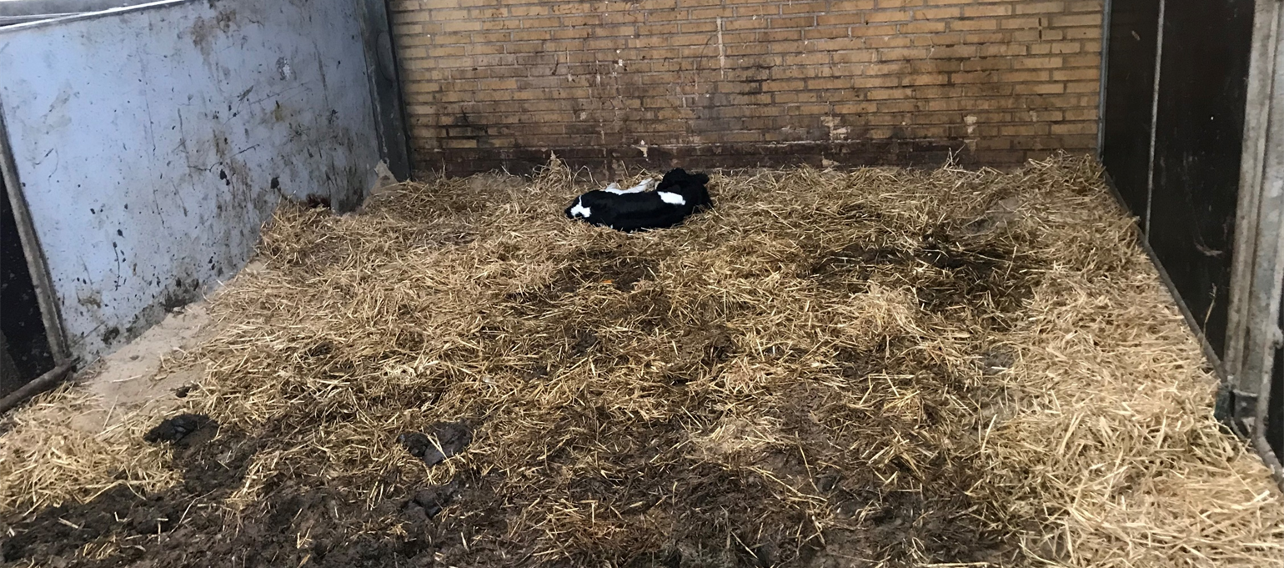
Calving pen – do we see the same?

Slide 12
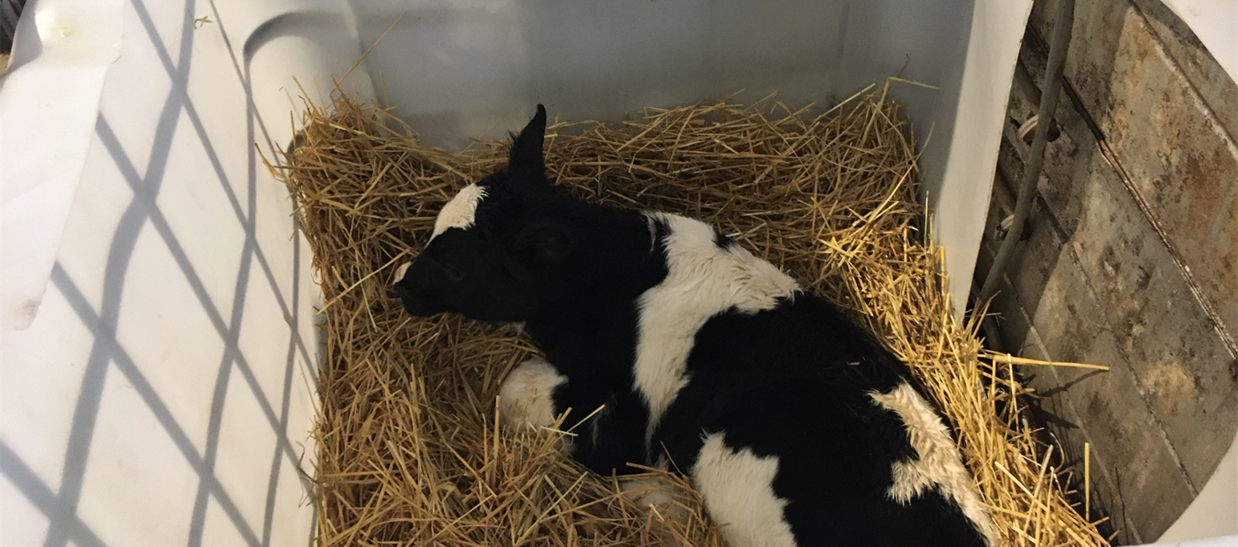
Find practical solution and be specific

Slide 13
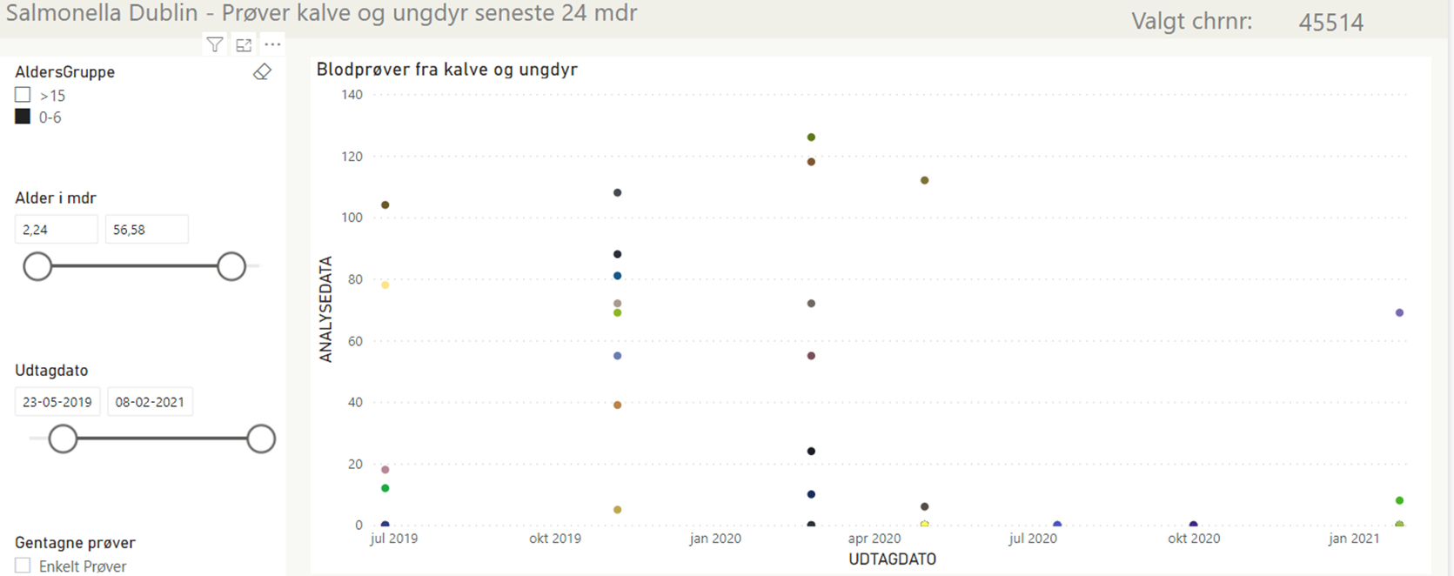
Follow-up

Slide 14

Questions?

