Slide 1

Surveillance and Eradication of Salmonella Dublin – the Danish Way
03-10-2022
SEGES

Slide 2
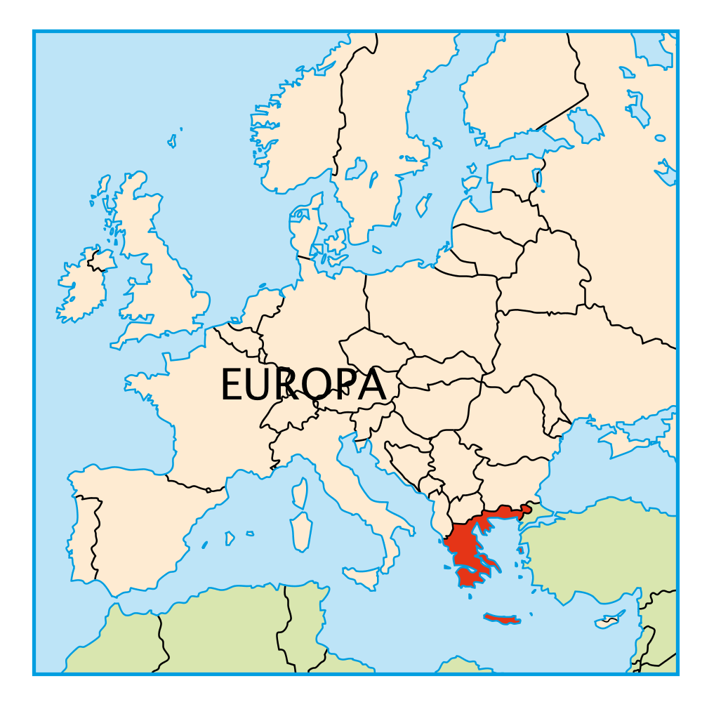
Denmark
Population 5.8 million people
Size 42.924 km2
Herds 15.863
Dairy herds 2351
Dairy cows 562.000
Average herdsize 246
Cattle 1.500.000

Slide 3
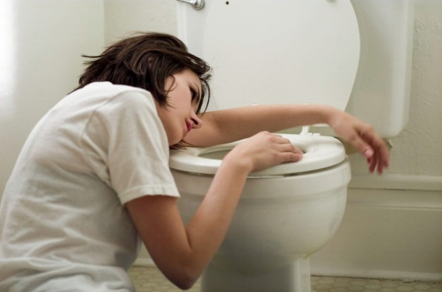
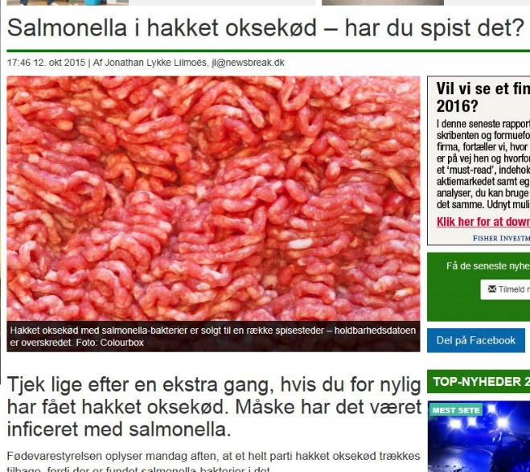
Salmonella Dublin - severe zoonosis
20-50 Human cases annually
Septicaemia
Difficult to treat
High mortality rate
Beef-Contaminated
Unpasteurised Milk Products

Slide 4
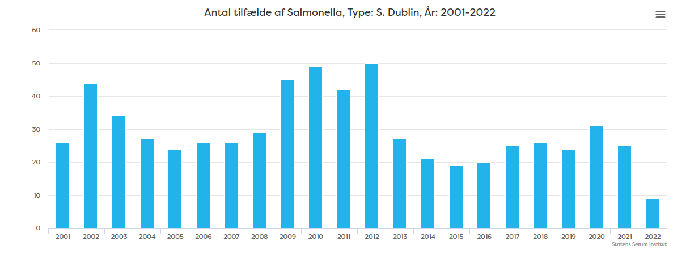
Humane S. Dublin cases in Denmark

Slide 5
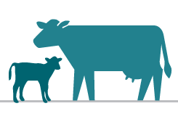
Why?
More disease in infected herds.
Less production in infected herds.
Risk of salmonella contamination to personnel in infected herds.
Risk of infection to other herds in the immediate vicinity
Risk of transmission of salmonella bacteria to beef-food safety.

Slide 6

Salmonella Dublin Facts
Salmonella Dublin is a bacteria that primarily infects cattle
The bacteria spreads primarily with faeces
Small doses of the bacteria leads to an increase in the antibody level in the animal
Calves under 6 months are most susceptible, but animals of all ages can be infected
Salmonellosis is difficult to treat with antibiotics
Salmonella can survive for months or years in the environment
Notes:
12-24 hours efter uptake in can be shed in faeces

Slide 7
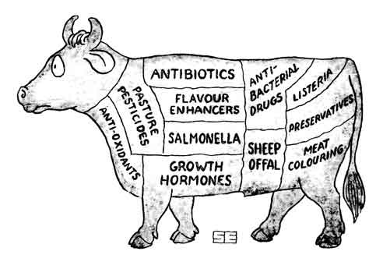
Consequence
What we know:
  Increased mortality
  Increased morbidity
  Reduced milk yield
What we think:
  Reduced growth and increased feed consumption
What we fear:
  Salmonella in meat at the slaughterhouse – or the consumer

Slide 8
Surveillance 2022
Surveillance
Bulk tankmilk
Herd
Blood, heifer rearing
Individual Animal
Blood from slaughter
Herd
Salmonella 4/yearly,
Salmonella 1 – 2/yearly
Salmonella 4/yearly,

Slide 9
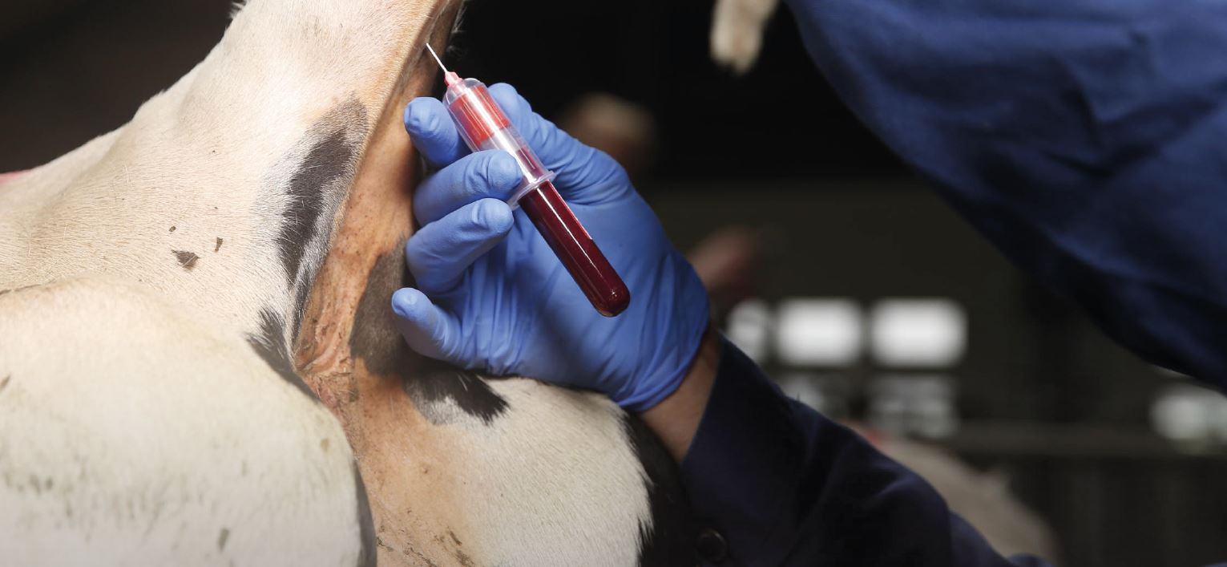
Definition of a Salmonella positive herd
Bulk tank milk antibody test (ELISA) above 25 ODC %
Average of the last 4 above 25 ODC %
A valid test – 21 days since last one
One positive blood sample – slaughter or test of animals in the herd (surveillance testing) – cut off value 50 ODC %
Positive blod samples from herd
Notes:
HUSK at der ikke må være en stigning på mere end 20 i forhold til gennemsnittet på sidste 3

Slide 10

Definition of level
Salmonella Dublin level 1 – probably free from Salmonella
Salmonella Dublin level 2 – positive herd, restrictions and demands for eradication etc

Slide 11
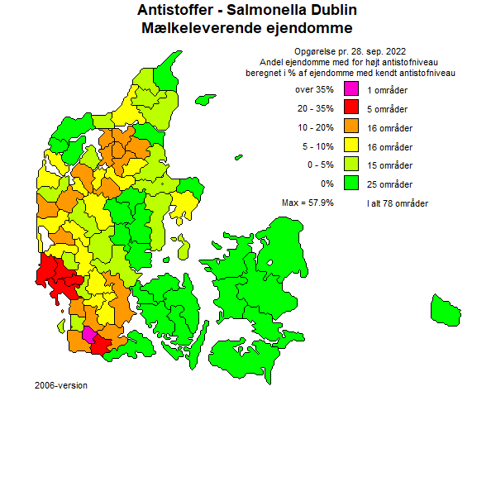
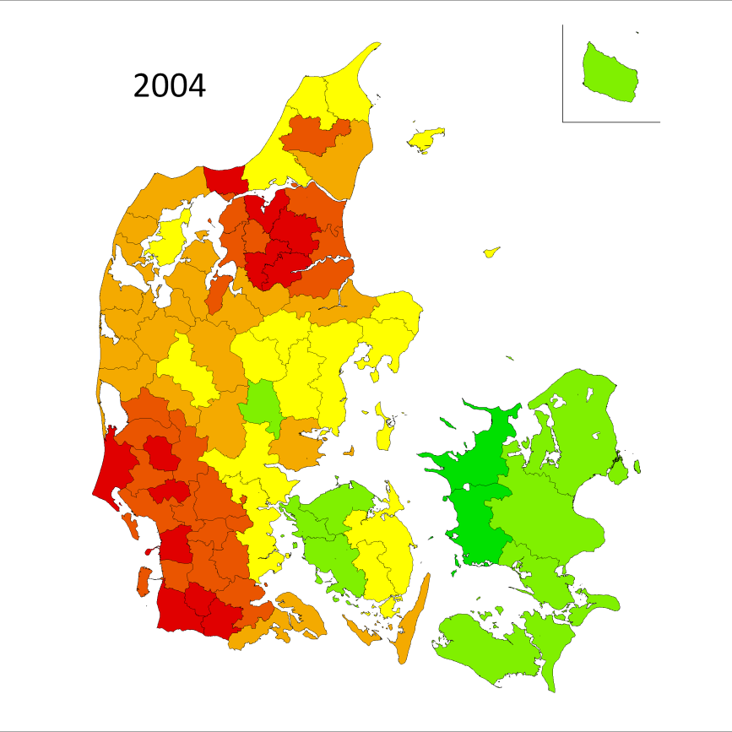
Development in dairy herds between 2004-2022

Slide 12
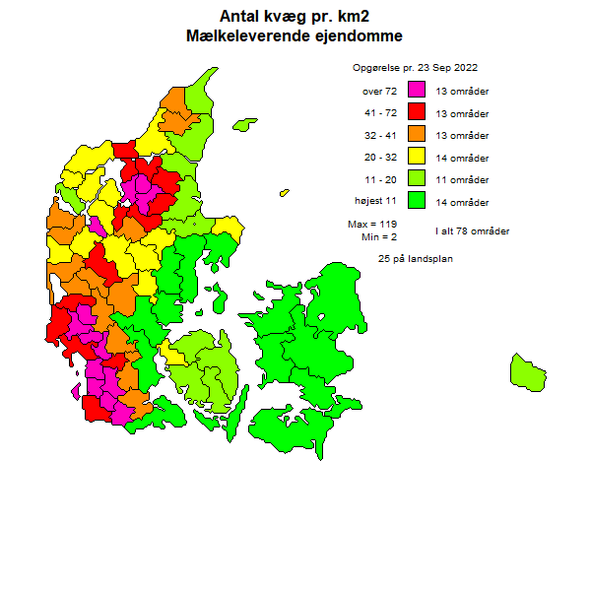
Cattle density and salmonella prevalence

Slide 13
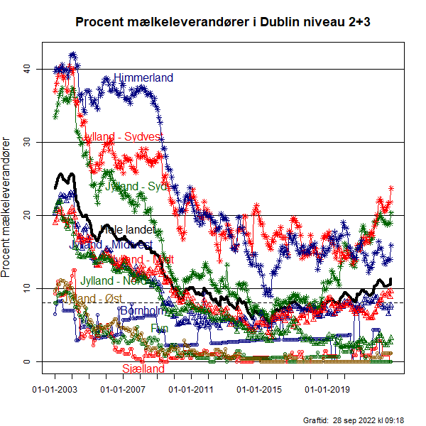
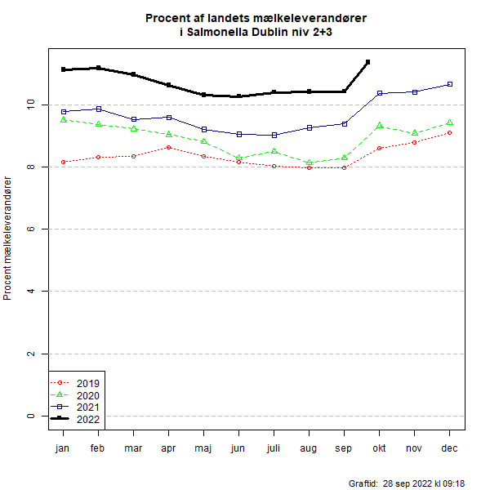
Development in Danish Dairy herds
2022

Slide 14
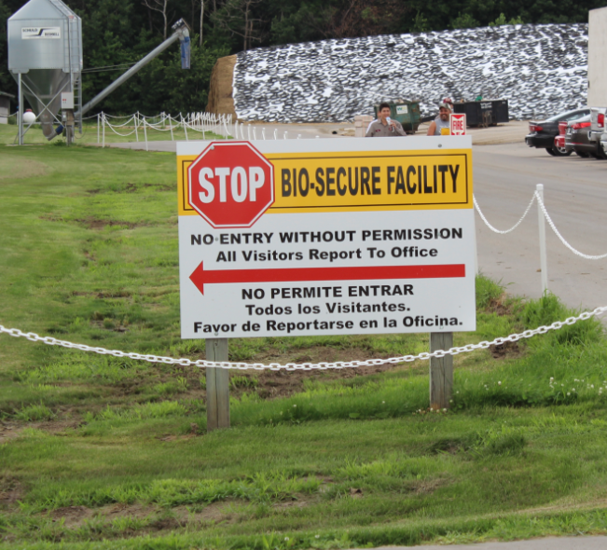
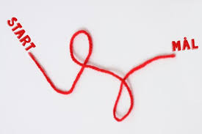
History – The Danish Program
2002 – surveillance starts
2007 – 2009 Voluntary effort
  Idea generation and testing, informations campaign
  Establishing advisory network, manuals, Farmer Fields Schools
2010 – 2012 Trading restrictions
2013 – 2016 Legislation for positive herds
2017 – 2019 Further restrictions for positive herds
2020 – GOAL………

Slide 15
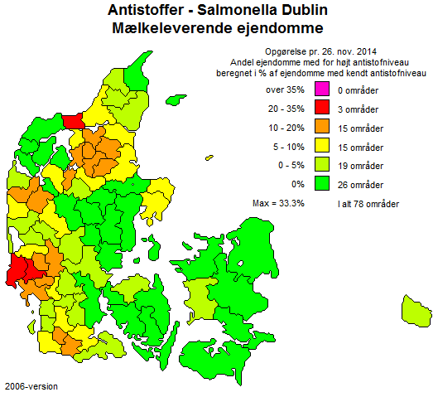
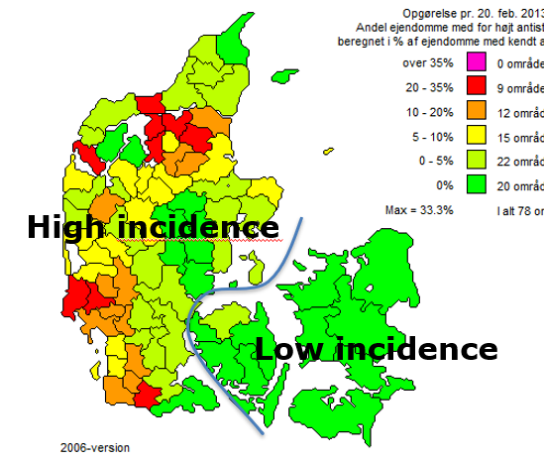
July 2014 – and again in 2015

Slide 16
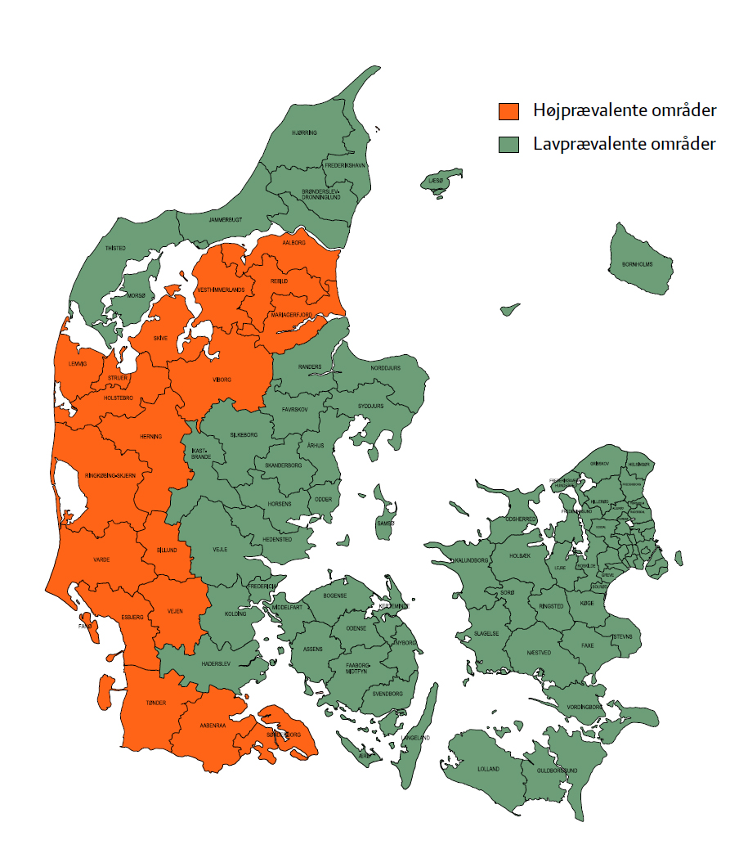

Slide 17
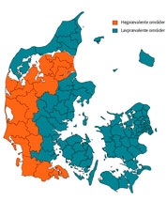
Regionalisation 2014-2018
To protect herds in low-incidence areas:
  Ban on movement of animals from high-incidence country parts to low-incidence areas, except:
  Male calves from level 1 to rose calfproduction, animals attending animals fairs,
Level 2 in low-prevalent areas is subject to restriction
From 2019
  Level 1 – free trading in all country
  Level 2 – NO trading – only slaughter or export

Slide 18
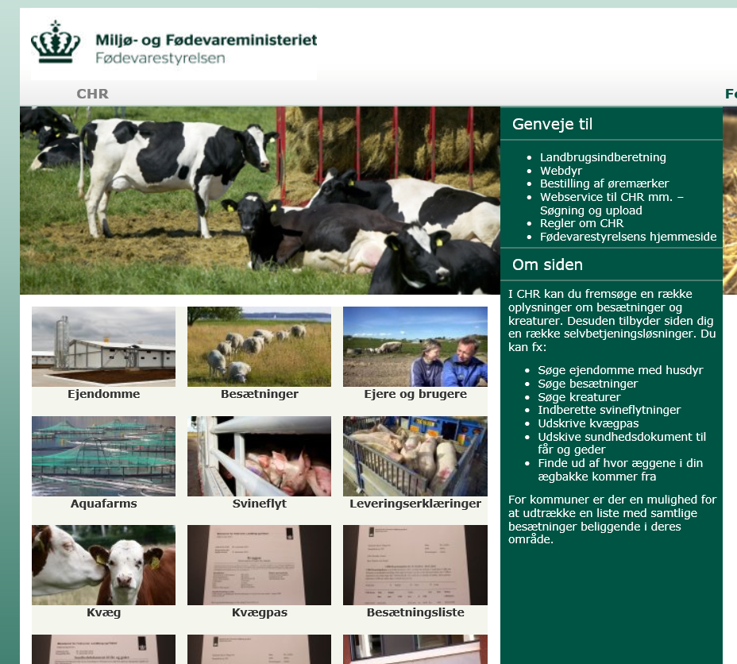
Salmonella program
Surveillance program with public access
Movement restrictions
Mandatory eradications in infected herds – herd-specific systematic action-plans incl. Test strategies
Official restrictions in all test-positive herds

Slide 19
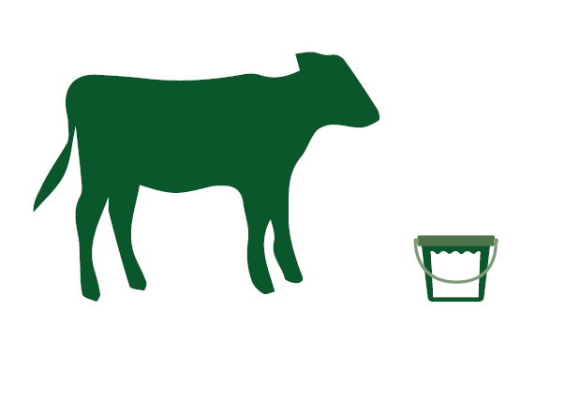
Mandatory control in the Level 2 Herds
Prohibition on the sale of livestock, excluding animals for slaughter, and animals for export
The herdowner shall, in cooperation with his veterinarian, prepare a herd-specific, active and time-limited action plan for the control of Salmonella Dublin
  Action-plan had specific requirements
The impact of the action plan shall be documented
  Quarterly Blood tests of 8-25 calves older than 3 months
  Two times pr year – testing of 25 heifers
Two times a year – control by authorities. Paid by herdowner

Slide 20
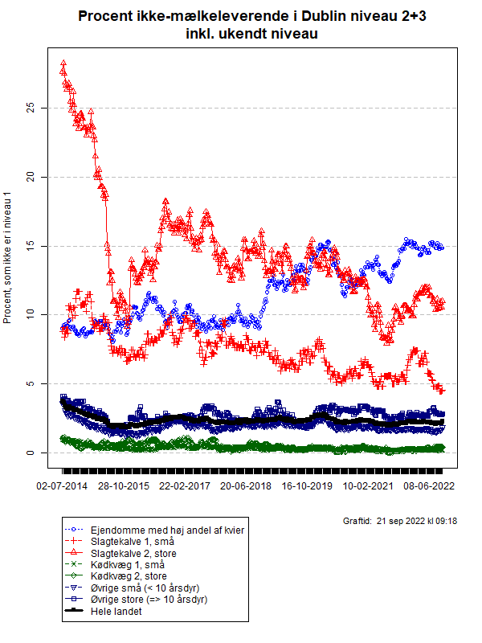
KalveTjek - CalfCheck
Gruppe | Antal ejendomme i alt | Ejendomme, som ikke er i niveau 1
 |  | Antal | Procent
Ejendomme med høj andel af kvier | 572 | 85 | 14,9%
Slagtekalve 1, små | 242 | 11 | 4,5%
Slagtekalve 2, store | 245 | 27 | 11,0%
Kødkvæg 1, små | 3.063 | 6 | 0,2%
Kødkvæg 2, store | 783 | 3 | 0,4%
Øvrige små (< 10 årsdyr) | 6.314 | 117 | 1,9%
Øvrige store (=> 10 årsdyr) | 960 | 27 | 2,8%
I alt | 12.179 | 276 | 2,3%

Slide 21
KalveTjek - CalfCheck
Veal calf producer buy in from many different dairy herds
If they buy in salmonella positive animals – status for salmonella will eventually change and they must produce and follow an action plan (level 2 restrictions)
Risktool made to lower their risk from buying in positive animals
Different levels of information available – permit from dairy farmers

Slide 22
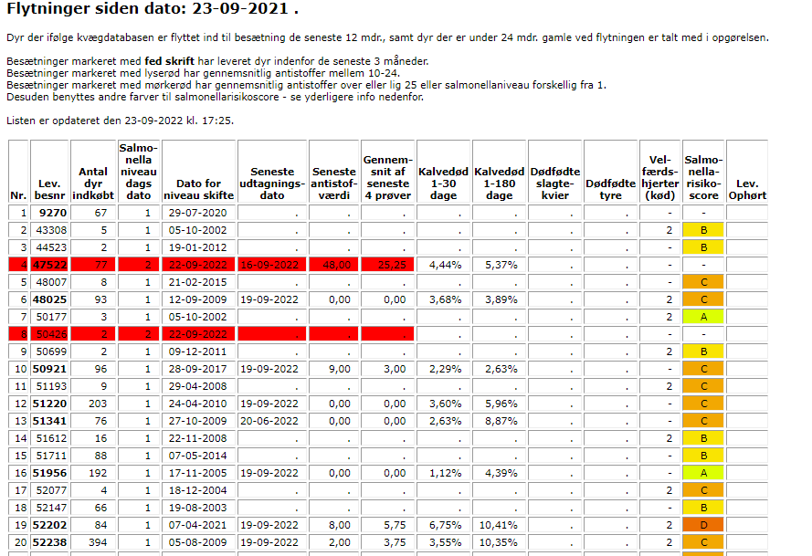

Slide 23
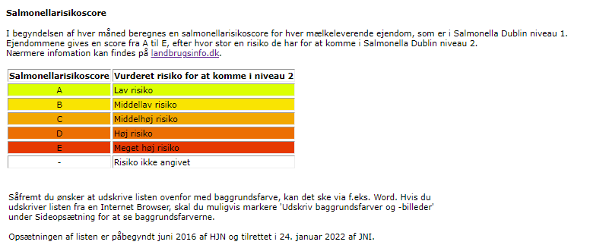

Slide 24
Farmvisits with Focus on Salmonella
Malene Budde, SEGES
04-10-2022

Slide 25
Background for the project:
Running for three years – 2020-2022
Funded by the Levy funds – It’s free of charge to participate
Main activities:
    Farmvisits
    Biosecurity
    How to use tests?
    Biogas and slurry

Slide 26

Project - helping farmers with salmonella
Farm visits – 155 farms participating
  Focus on hygiejne
  Farmer knowledge
  Motivation
  Action-plan
Follow-up
Cooperation with herd-vet

Slide 27
What do we do at a farmvisit?
Walk through stables – observe and ask
Risk assessment
Understanding the farmer and his situation
Farmer knowledge and motivation
Making an actionplan
Notes:
På Salmonellabesøgene skal vi. Systematisk gennemgang af besætning for at afklare risiko-områder i forhold til Salmonella. Men mindst lige så vigtig så skal vi vide noget om de mennesker vi står over for.
”De bløde værdier” bliver lidt overset. De kan være svære at spørge ind til. Det er nemmere at spørge om hvor tid de muger kælvningsboksen. I starten et spørgeskema udarbejdet af en kollega. Nu er spørgsmålene en integreret del af samtalen. ”Hvordan har du det med at have Salmonella?”

Slide 28
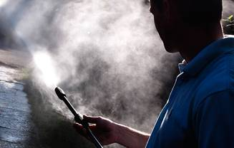
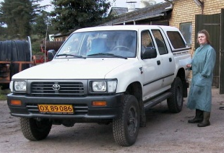
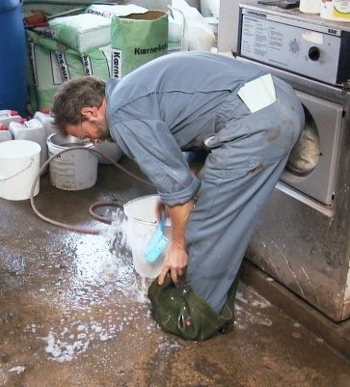
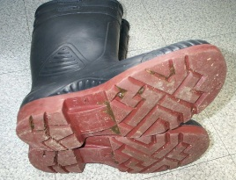
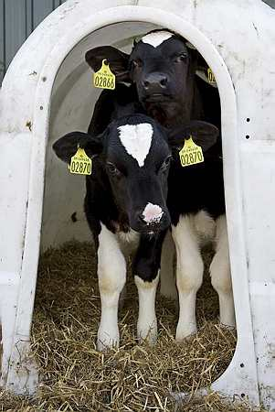
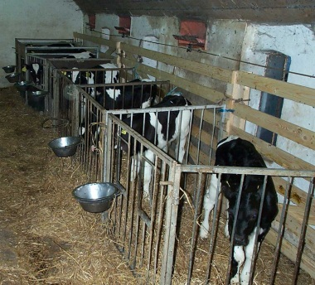
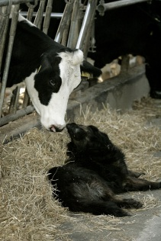
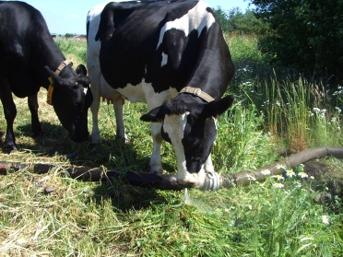
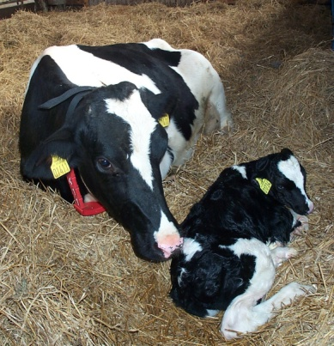
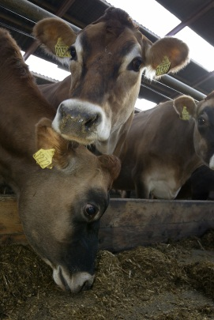
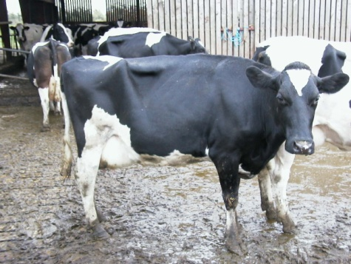
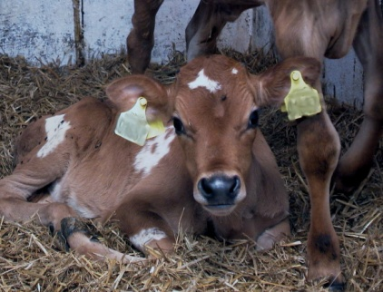
Transmission rutes
We only need a few grams of faeces with salmonella from another calf or cow to be infected with
Salmonella Dublin!
Aerosoler
People
Calf housing
Calving pen
Carriers
Environment
Pen buddies

Slide 29
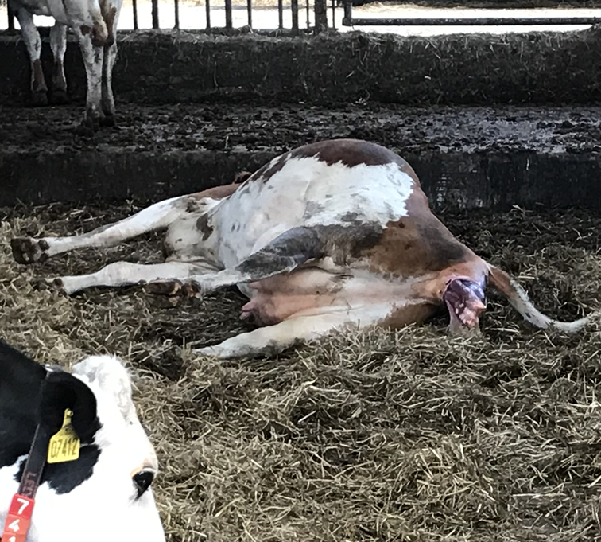
Calvingpen – where we start:
Hygiene
Stocking density
Sectioning

Slide 30
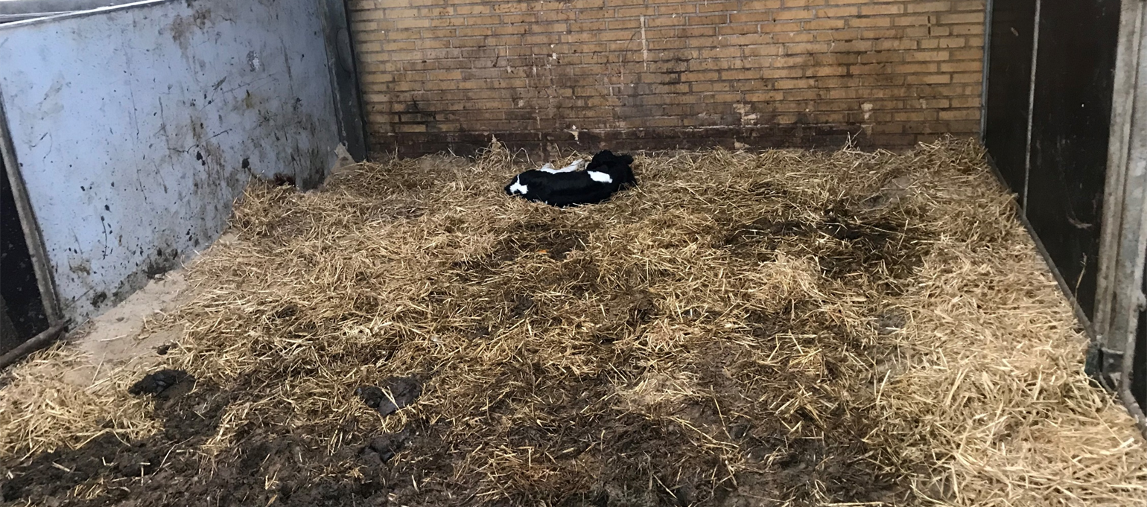
Calving pen – do we see the same?

Slide 31
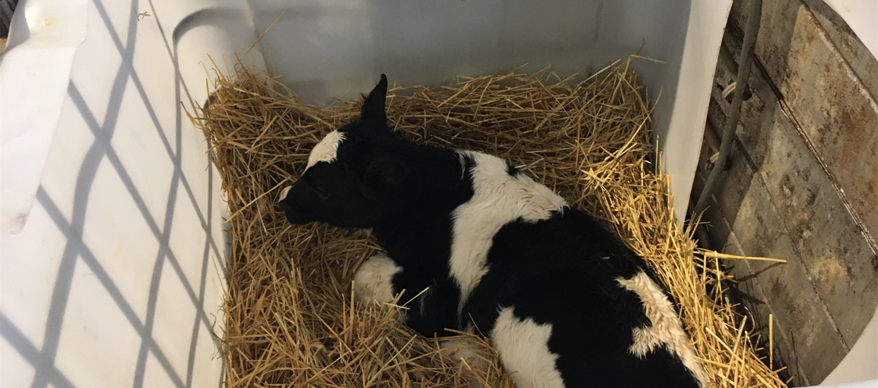
Find practical solution and be specific

Slide 32
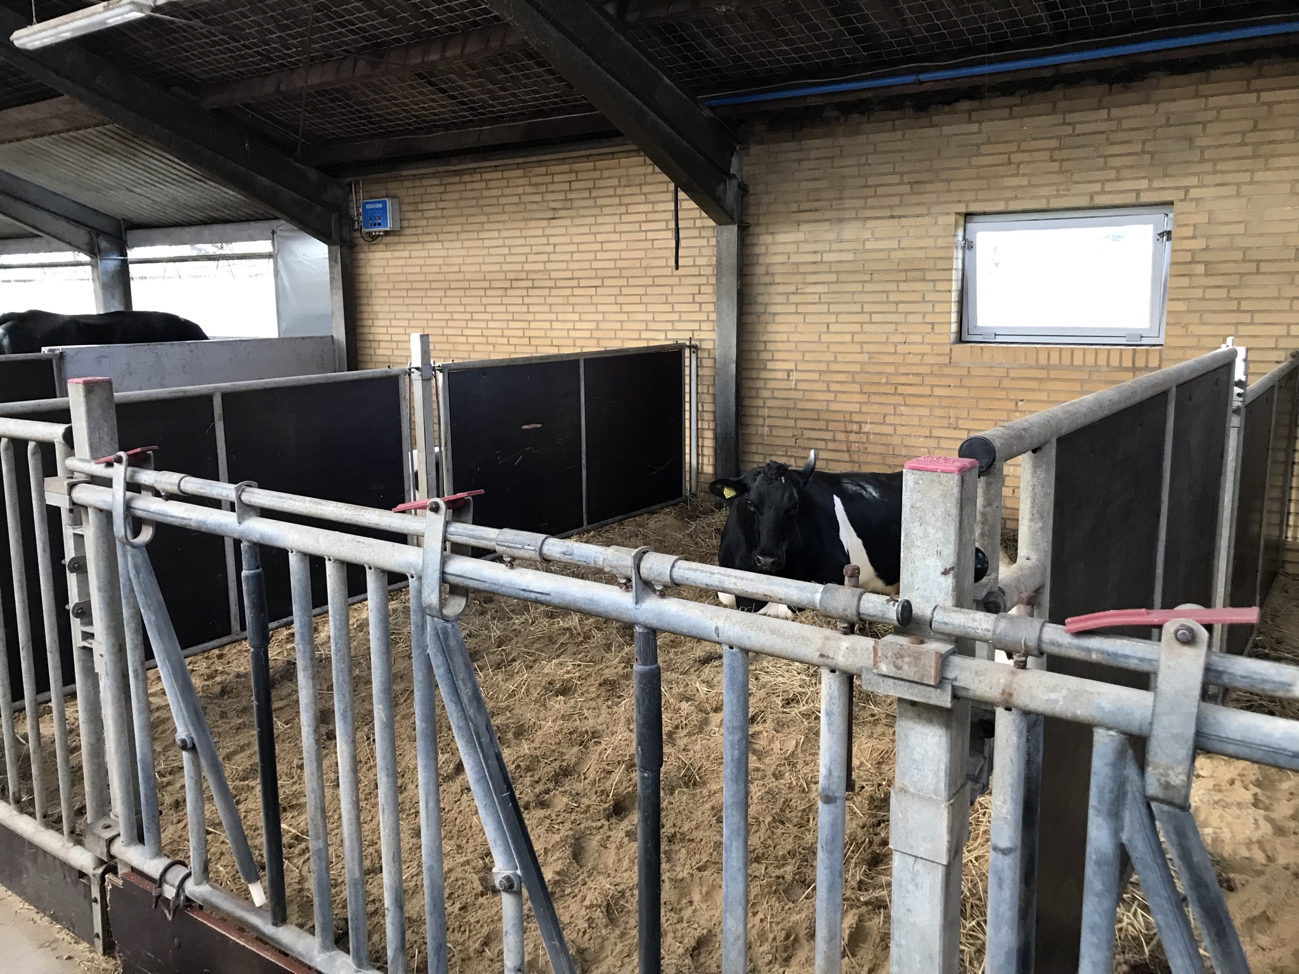
After

Slide 33
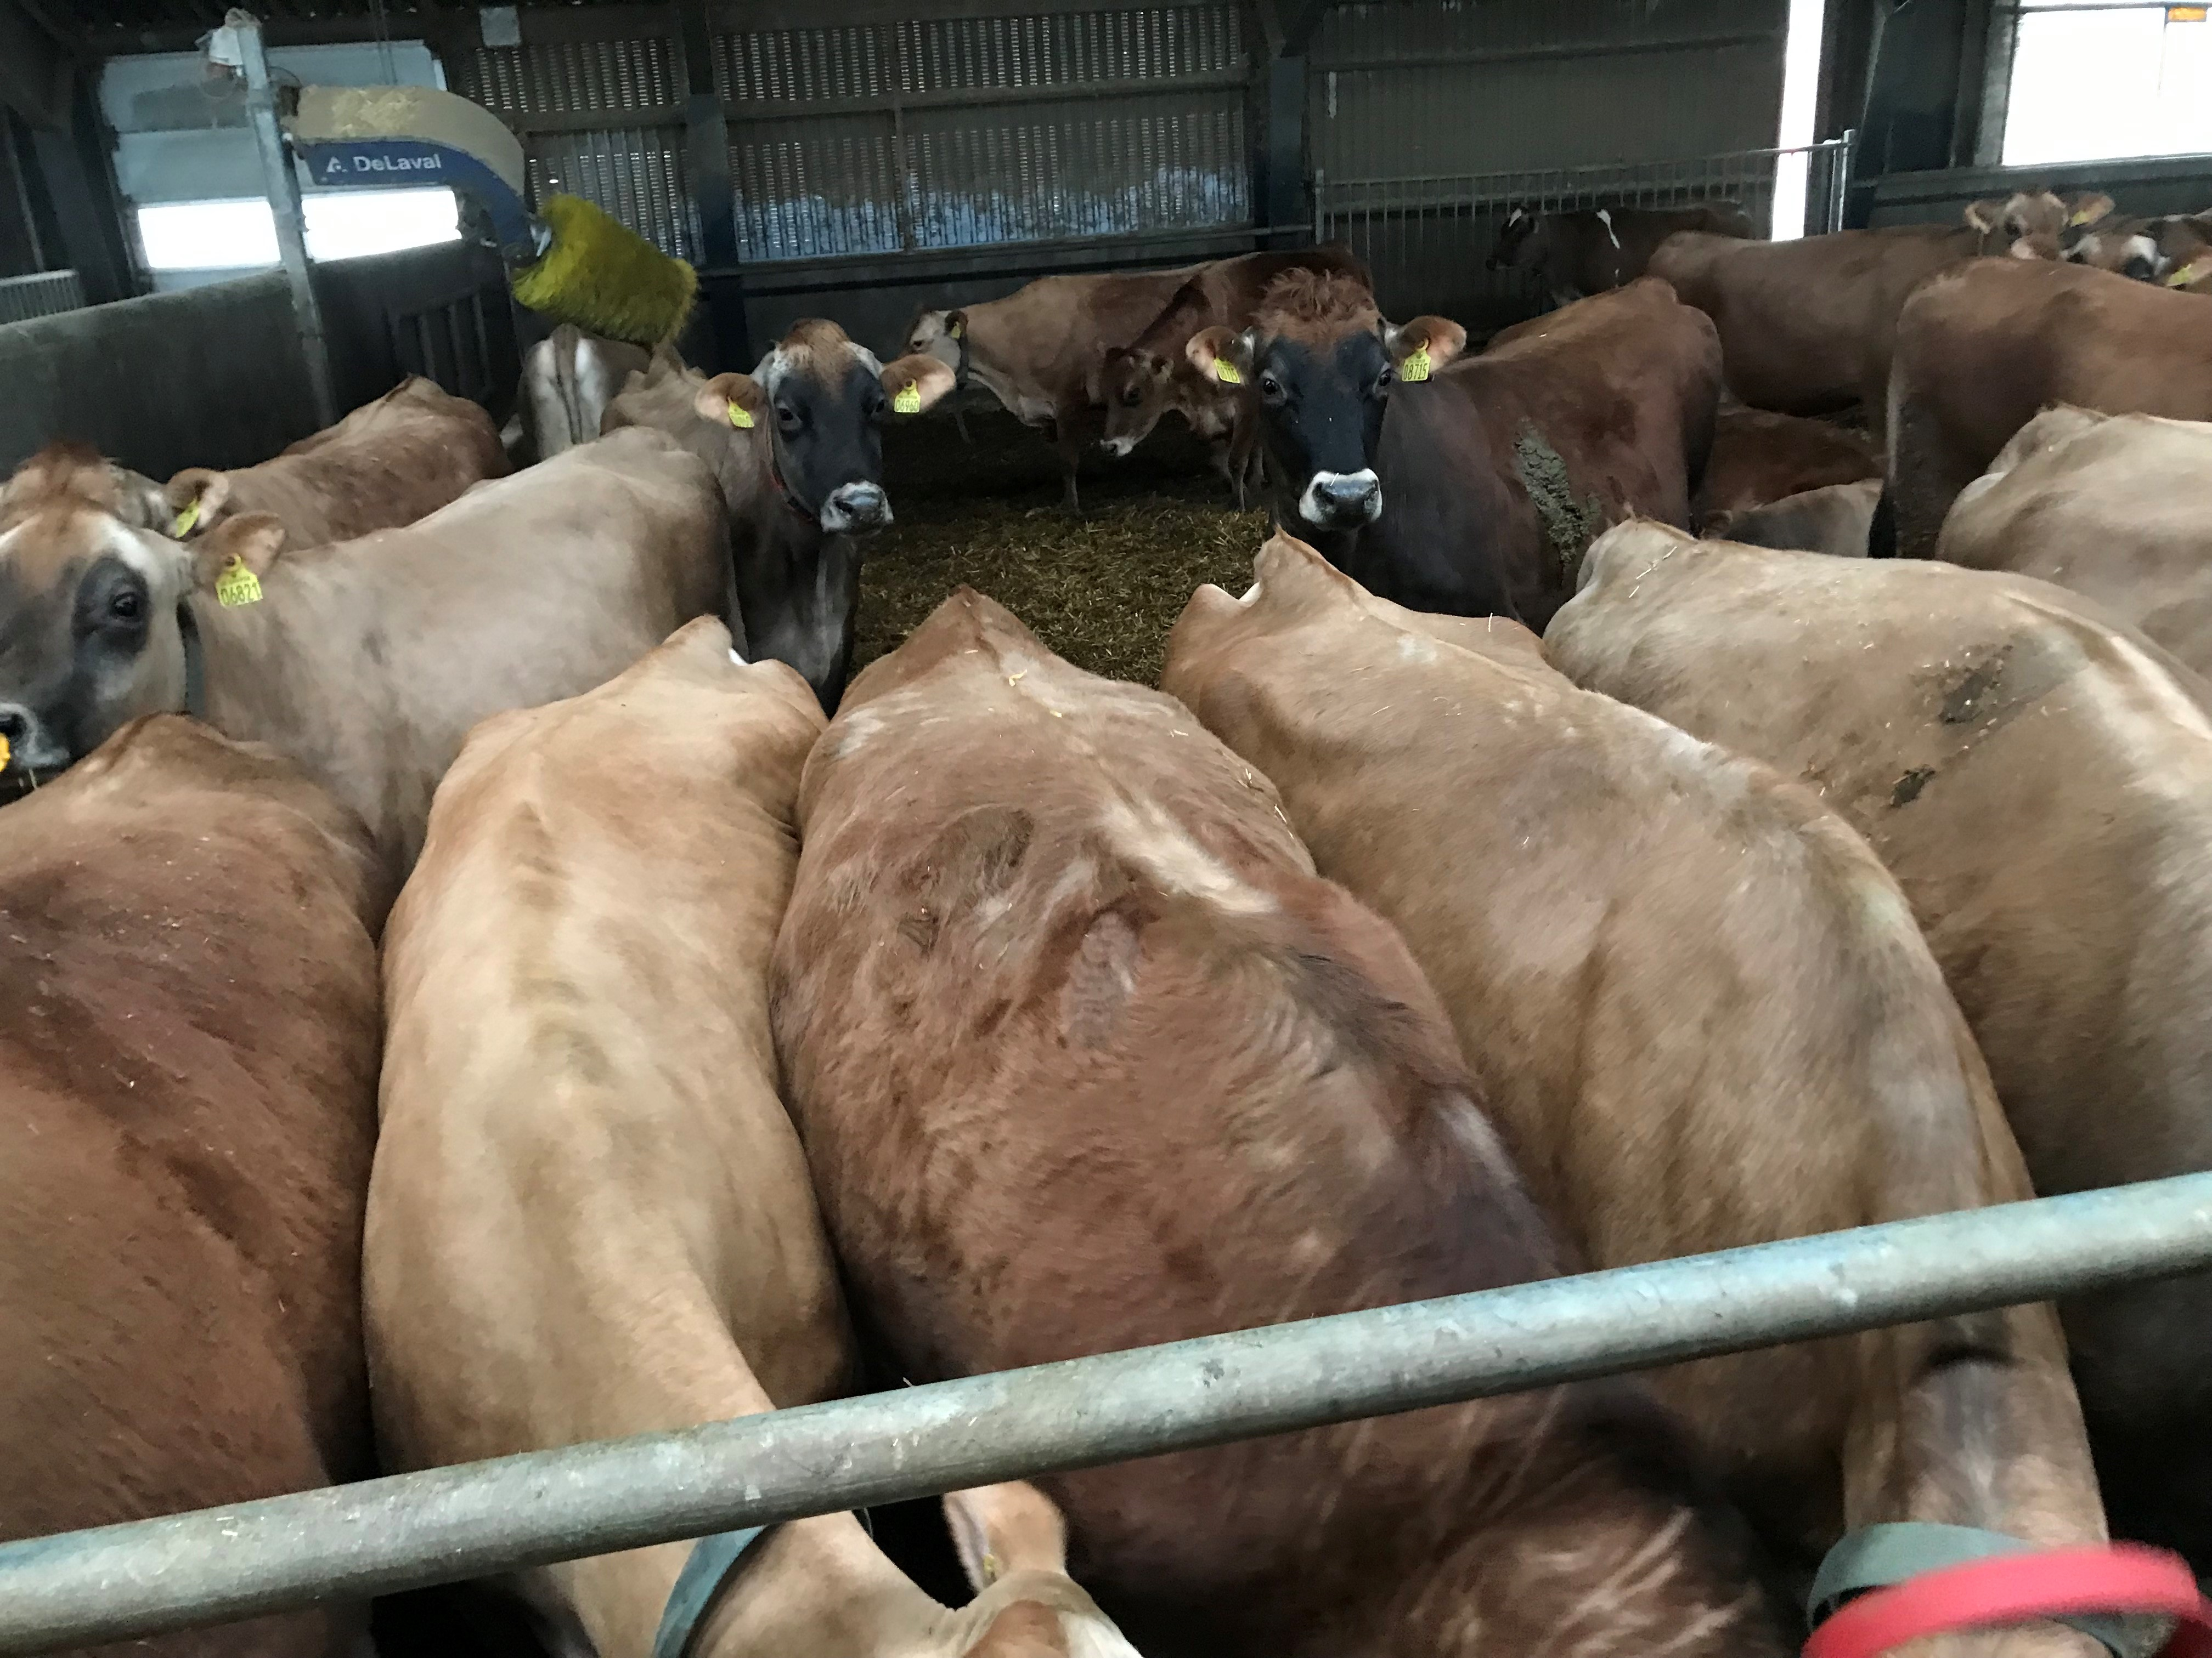
Calvingpen – Stocking density

Slide 34
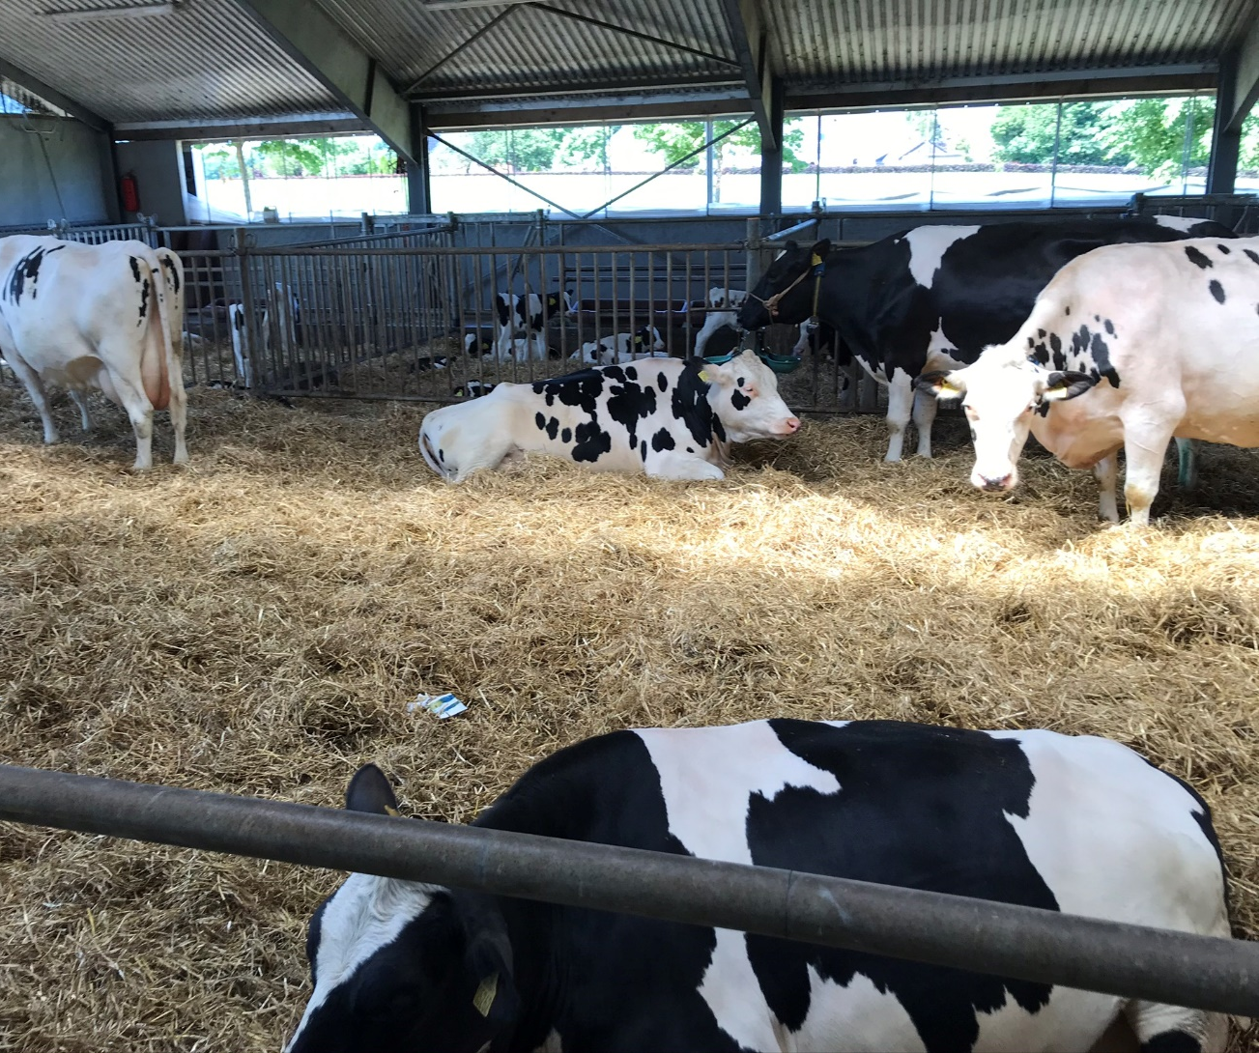
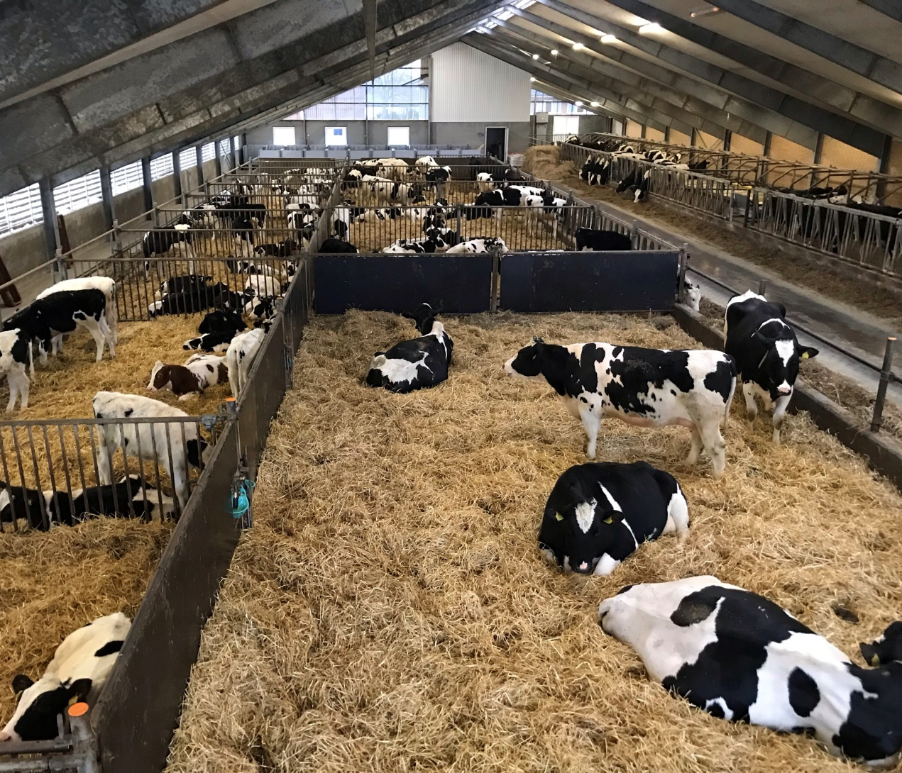
Calvingpen - Sectioning

Slide 35
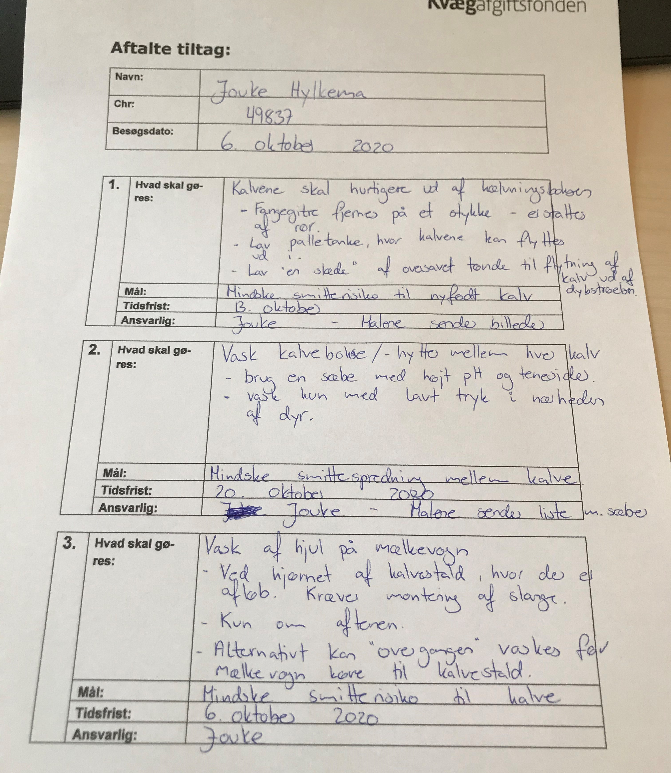
Actionplan :
Ownership
“Keep it simple”
Be specific!
Notes:
Jeg har en tilståelse. I min tid som praktiserende har jeg skrevet utroligt lange rapporter og handlingsplaner bag mit skrivebord. De blev sjældent til noget ude i besætningen. Det er landmanden der udvælger tiltagene, Keep it simple, vær konkret! Hurtigst muligt hører ikke til i en handlingsplan. Rengøring og desinfektion. Vær sikker på, at din og landmandens definition er den samme?

Slide 36
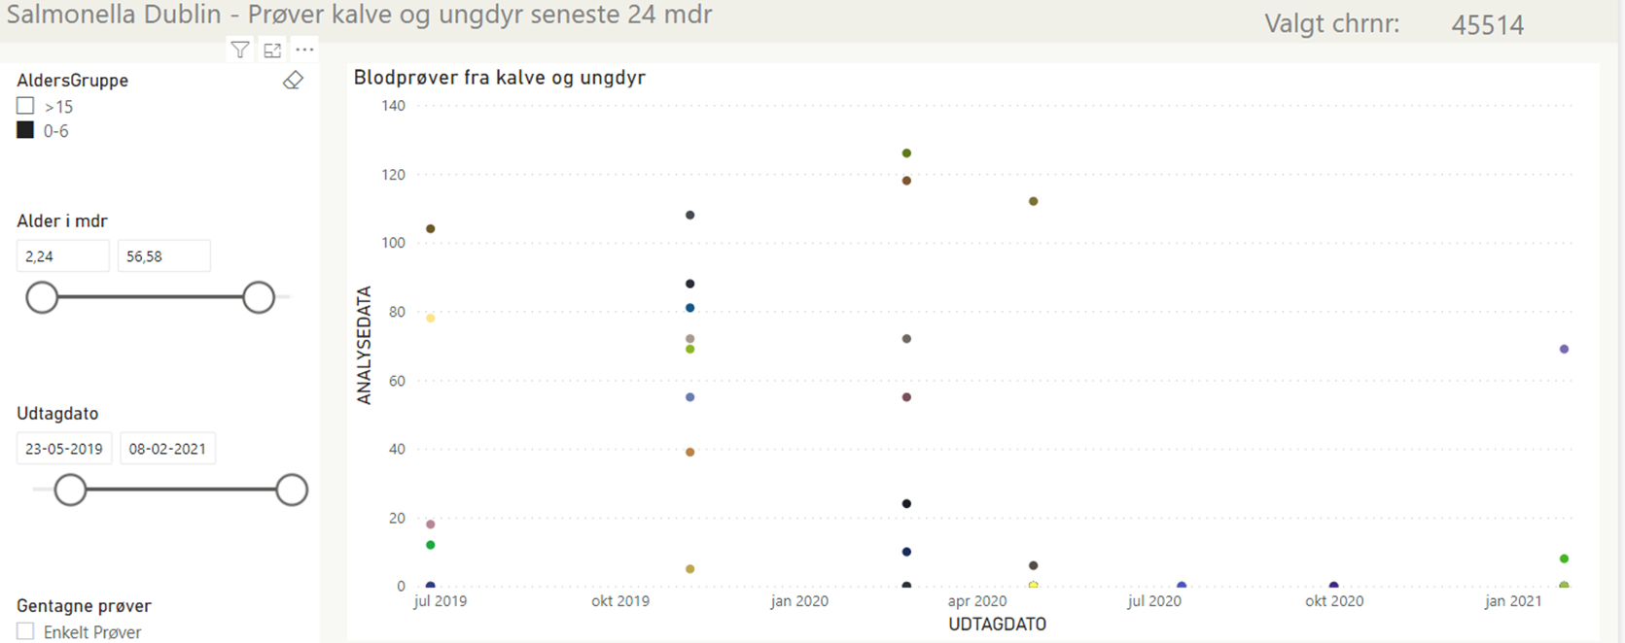
Follow-up

Slide 37
Results
28 of the155 farms are in status 1(18%)
Many farms are close☺
But it requires an effort at the farm!
Notes:
Husk FVST respons – at embedsdyrlægerne er begejstrede for vores besøg og at de besøgte landmænd på kontrollerne er meget galde for Malene og Betinas besøg

Slide 38

Questions?

